Slide 1
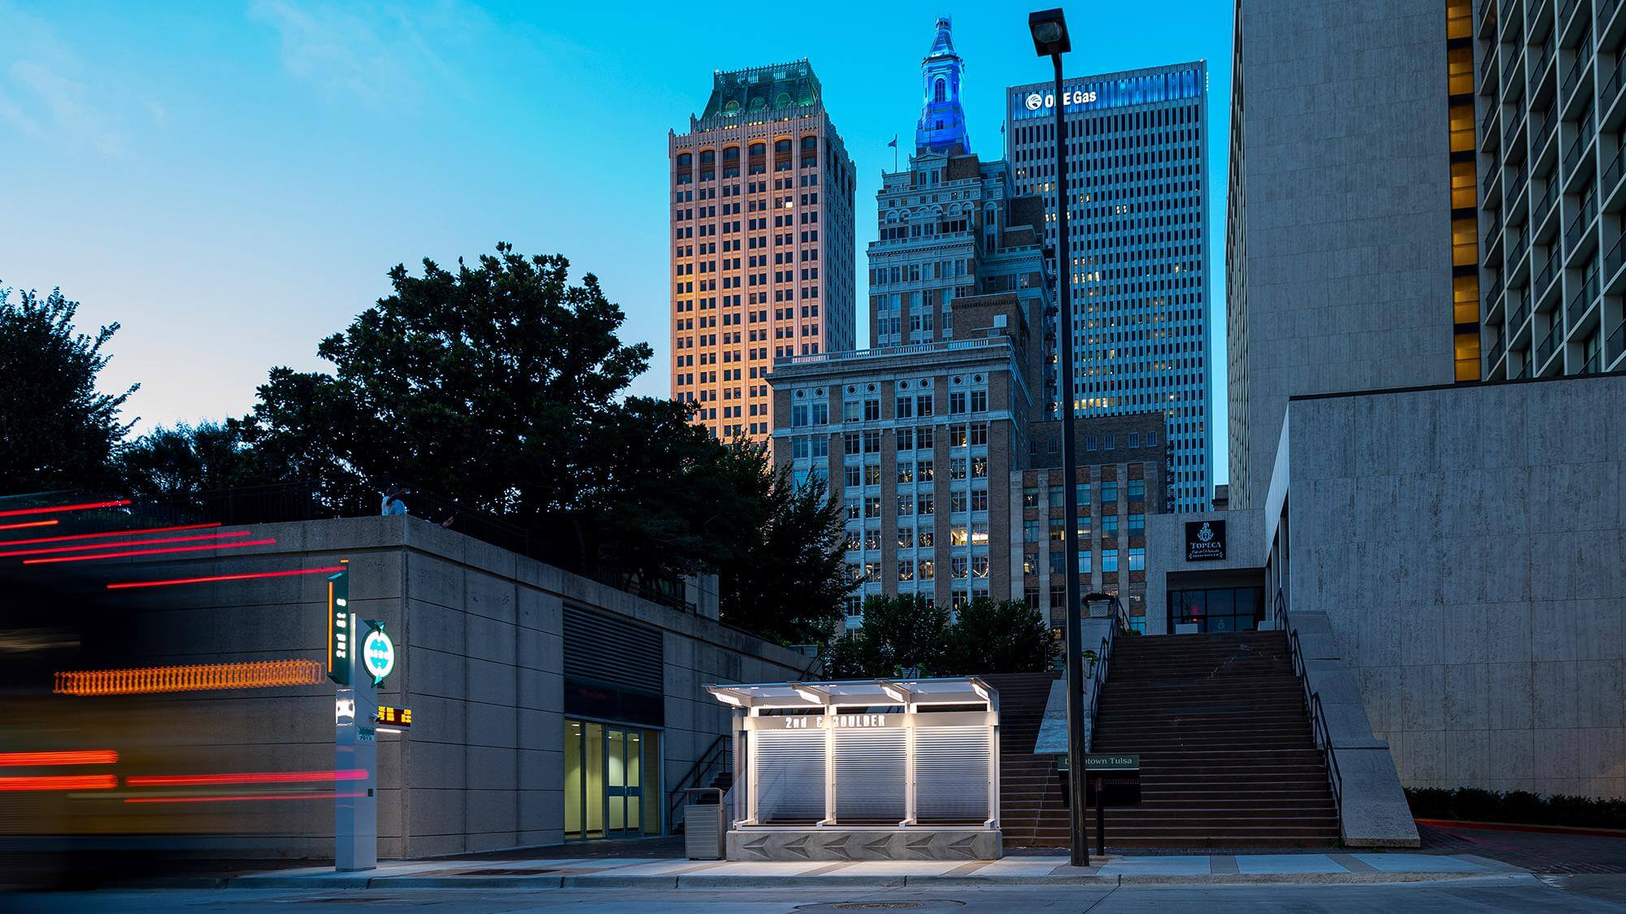
Public Outreach Session December 2023 Changes

Slide 2
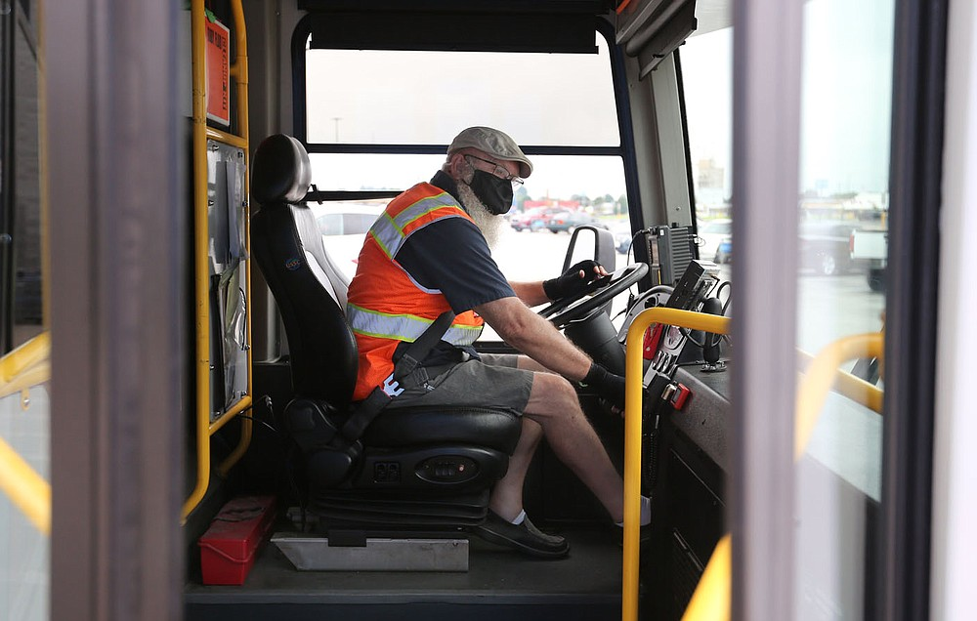
Background
Response to customer surveys and feedback
Changes to improve frequency & reliability
Expansion of Microtransit
Expanding job access
CONNECTS PEOPLE TO PROGRESS & PROSPERITY

Slide 3
December 2023 Service Changes
Microtransit, Nightline & Sunday
Zone 4 & 5 combined
Zone 6 – Gathering Place, expanded South to Tulsa Hills, & north to Goodwill
Zone 7 - Expanded north to 31st St.
Microtransit, Daytime
NEW Zone 8 - North Tulsa / Turley
NEW Zone 9 - Northeast Tulsa (Amazon/Airport/etc.)
*Zone 6, see above
Routes Eliminated
Route 109, low ridership
Routes with Significant Changes
Route 110, geography
Routes with Improved Frequency
Route 130, now every 30min
Route 140, now every 35min
Routes with Minor Changes
Route 112, timing
Route 114, timing
Route 320, timing

Slide 4
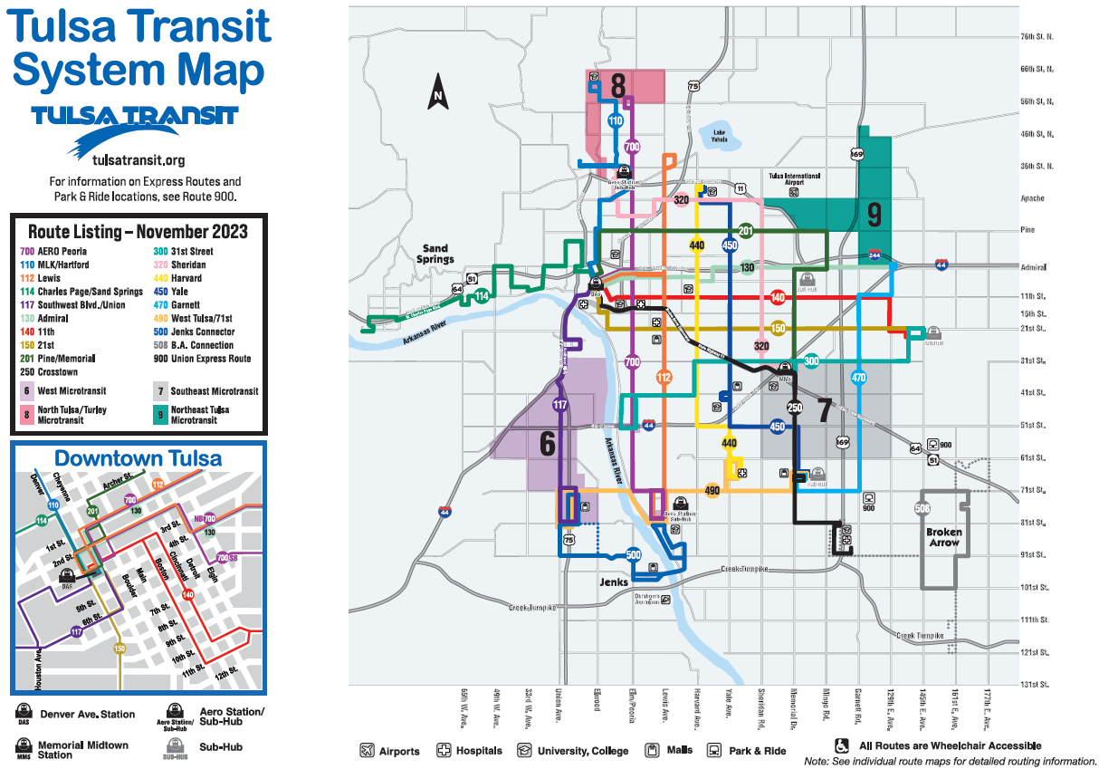

Slide 5
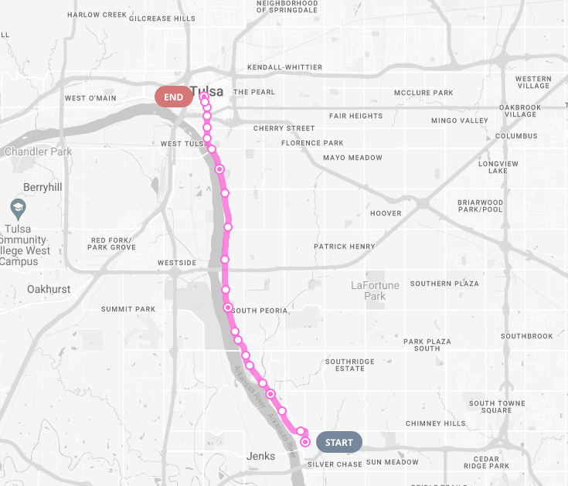
Route 109: Removed
DAS
Created to serve Gathering Place and other Riverside Destinations
~2 people per day at Gathering Place
Route has very low ridership
4K trips per month, lowest performing route
IMPACT OF CHANGE: Respond to riders by increasing frequency & reliability on Routes 130, 140, and 112

Slide 6
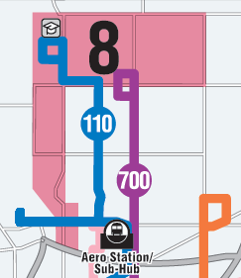
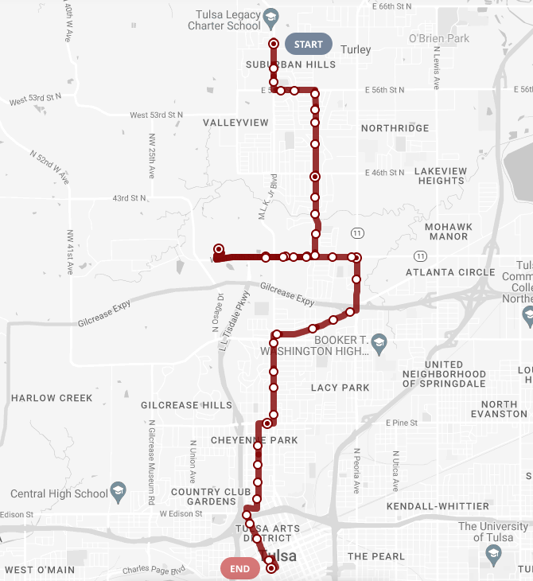
Route 110:
Redesigned
Frequency: Bus still comes every 30min
Geography:
Warehouse Market, Dream Center, and Westview Clinic removed from 110 and are now served with Micro
*NEW* Microtransit Zone
Warehouse Market, Dream Center, and Westview Clinic now served with Micro
Now services Senior Living Facilities!
IMPACT OF CHANGE: Respond to riders by increasing frequency & reliability on Routes 130, 140, and 112
Removed
Warehouse Market
Dream Center
Westview Clinic
Senior Living Fac.

Slide 7
Other Changes to Local Bus Service:
Bus Frequency Increase
Route 130 – Now every 30min, by additional bus
Route 140 – Now every 35min, by additional bus
Improvement to Reliability
Route 112 – Same frequency but added a bus to improve reliability
Route 114 – Adjusted times and decreased headway from 50 to 55min
Route 320 – Adjusted times and decreased headway from 45 to 50min
How did MTTA accomplish this?
Service reductions on Route 109
Minor frequency reductions when necessary
Supplementing bus service with Microtransit

Slide 9
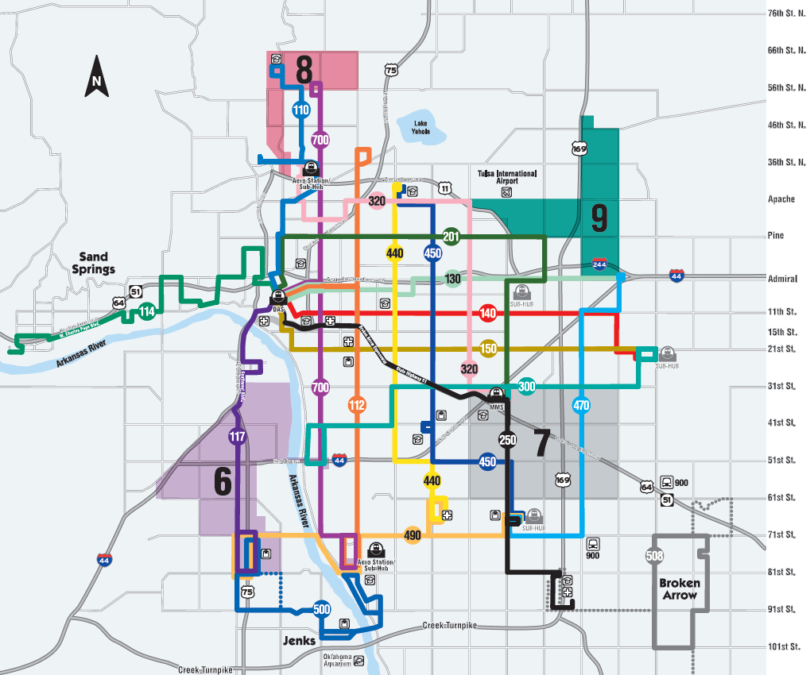
Microtransit Daytime
*NEW* Zone #8
Serves Areas removed from Route 110: Warehouse Market, Dream Center, and Westview Clinic
Now services Senior Living Facilities!
*NEW* Zone #9
Amazon, CostCo, Airport & various employers in area
Accessible by x4 Bus Routes
Zones 6 & 7 Expanded
6- Gathering Place, T. Hills, Goodwill
7 expanded to 31st St.

Slide 10
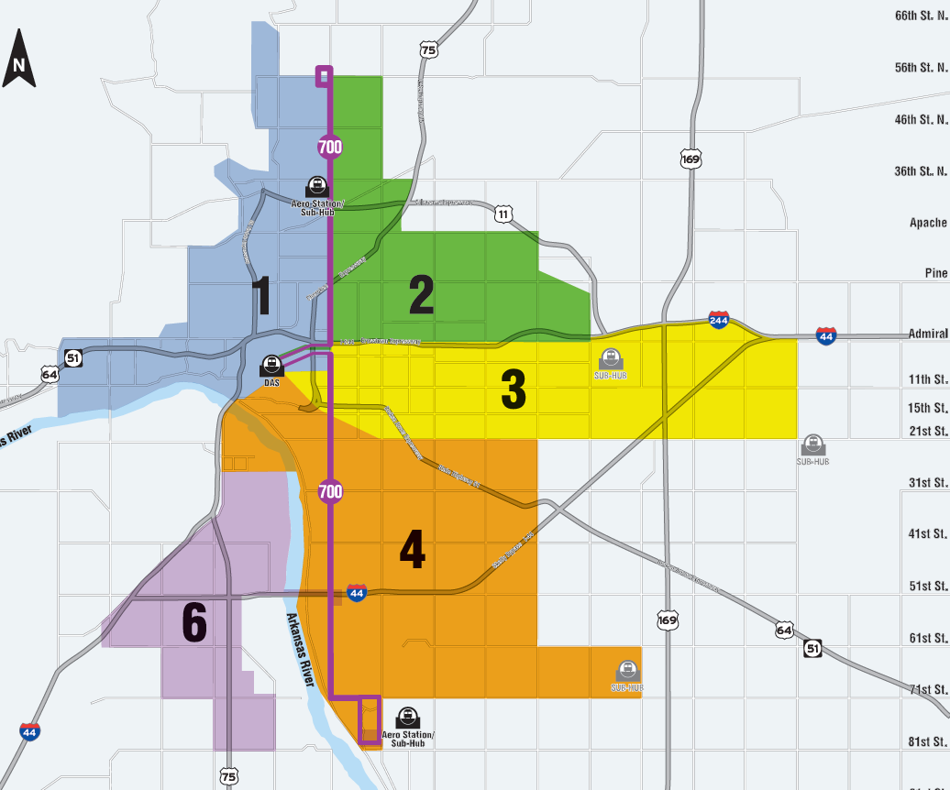
Microtransit Nightline / Sunday
Combined Micro Zones 4 & 5
Named Zone 4
Zone 2 can now access Admiral Walmart
Expanded Zone 6
Gathering Place is now Point of Interest
Now serves Tulsa Hills Shopping Center
Now includes Goodwill on SW Blvd.

Slide 11
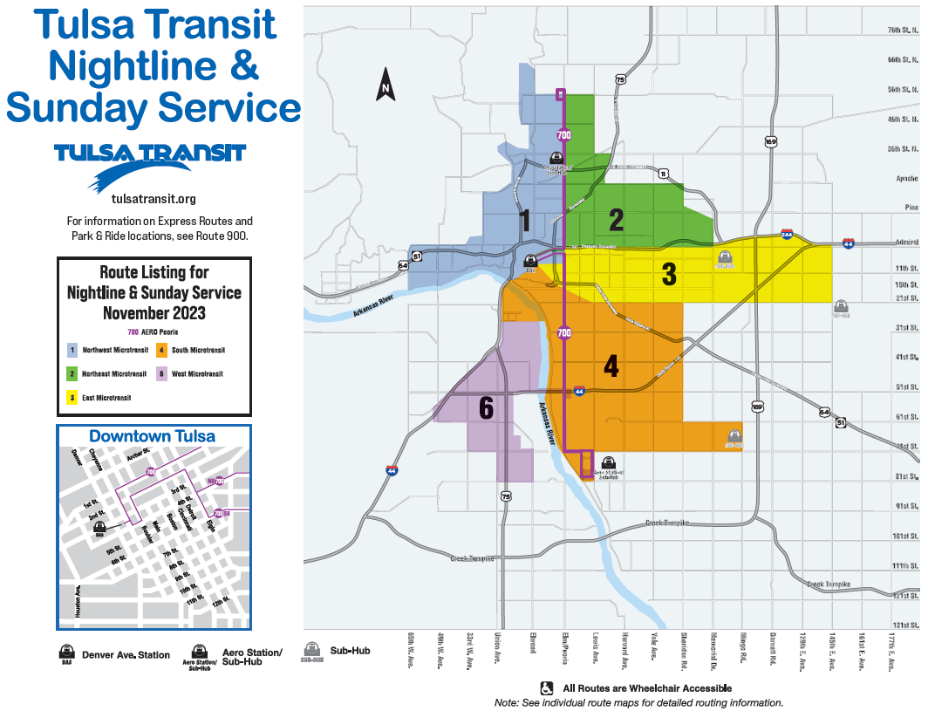

Slide 12
Thank you!
CONNECTS PEOPLE TO PROGRESS & PROSPERITY

