Slide 1
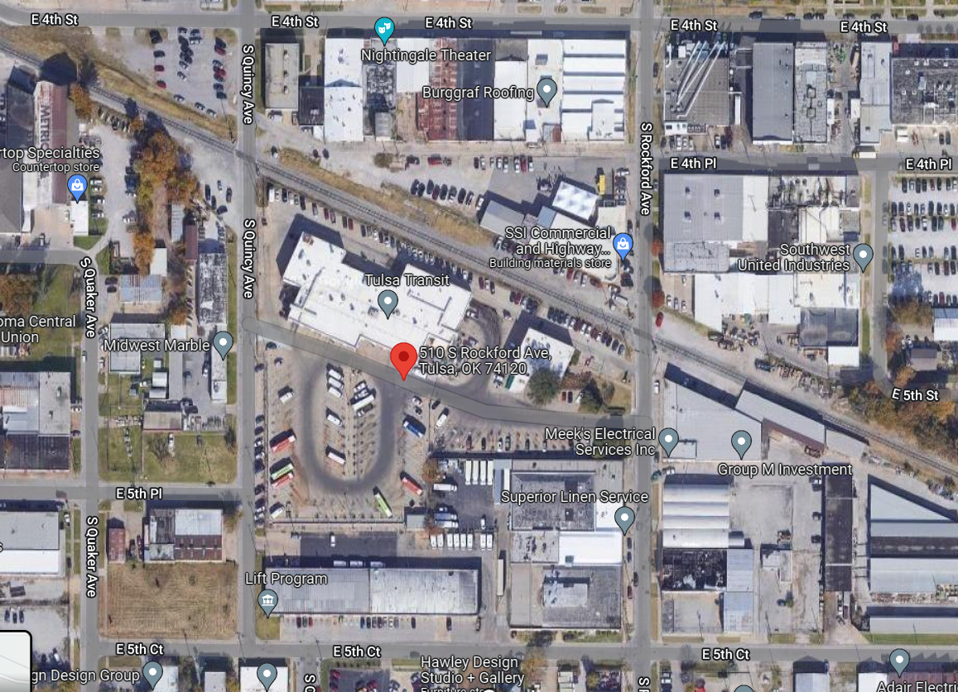
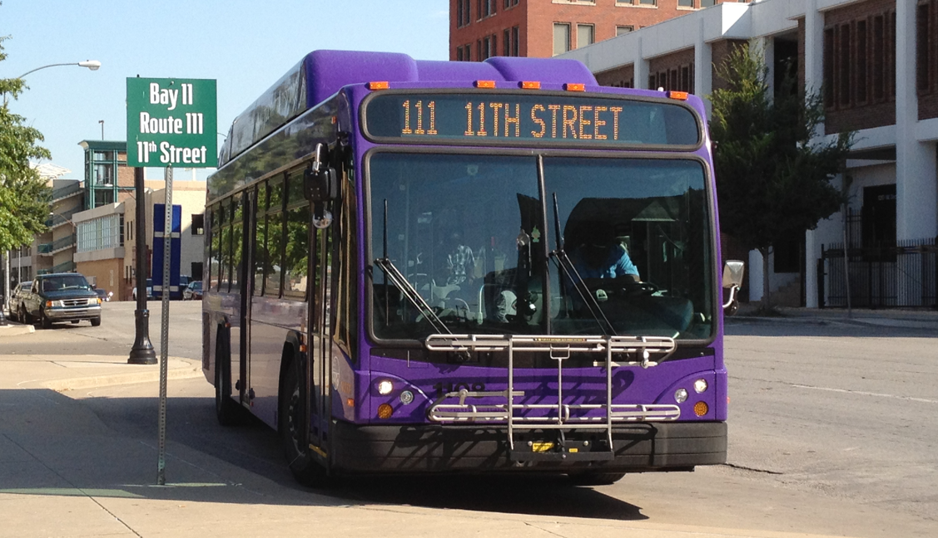

Tulsa Transit – Facility Feasibility Study
Tulsa Transit Facility - Public Open House
WELCOME!
December 8, 2022

Slide 2
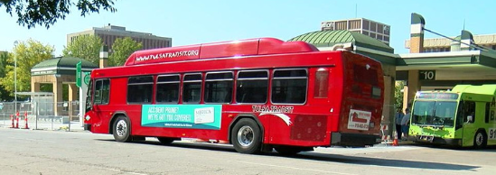



AGENDA
Scott Marr – Tulsa Transit General Manager
  Welcome and Introduction of Tulsa Transit Project Team
  Technical Committee
  Consultant Team
Process
Facility Vision
Programming
Site Locations
Next Steps
Introductions
Process
Facility Vision Discussion
Programming
Site Locations
Next Steps
Introductions
Process
Facility Vision Discussion
Programming
Site Locations
Next Steps
CONNECTS PEOPLE TO PROGRESS & PROSPERITY

Slide 3
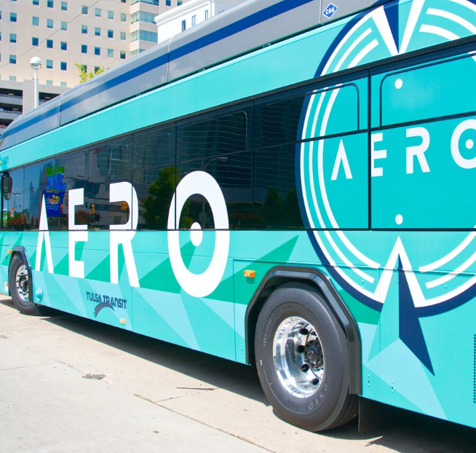
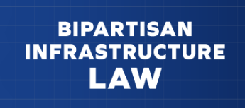
WHY A TRANSIT FACILITY NOW?
Existing Transit Campus is at Capacity
Growth on the Horizon
Significant Increase in Federal Transit Administration Funding
Opportunity for Increased Operational Functionality
CONNECTS PEOPLE TO PROGRESS & PROSPERITY

Slide 4
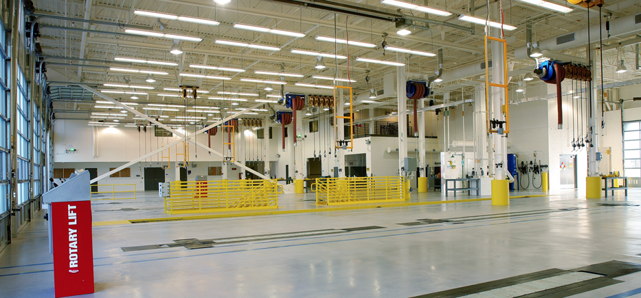


ASSUMPTIONS
Tulsa Transit will Pursue and Maximize Federal Transit Administration Funding
Follow FTA Requirements for Planning, Public Engagement, Environmental, Design, Construction
  Existing FTA guidance specifically indicates the basis for new or renovated maintenance, administrative facilities should be documented in a feasibility study, including the elements listed below.
    Evaluation of the existing facility for condition and adequacy
    Development of site criteria
    Evaluation of alternative sites
    Completion of Title VI Equity Analysis
Facility will House All Transit Functions – Operations, Maintenance, Garage, Call Center, Administration
Eligible Sites within Proximity of Transit Routes
CONNECTS PEOPLE TO PROGRESS & PROSPERITY

Slide 5
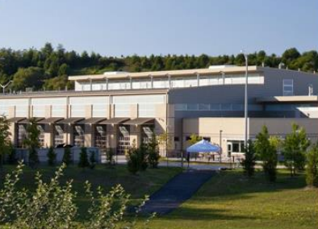
FTA CAPITAL PROJECT PROCESS
Defined Process and Expectations
Planning, Public Engagement, Environmental, Design, Construction
  Existing FTA guidance specifically indicates the basis for new or renovated maintenance, administrative facilities should be documented in a feasibility study, including the elements listed below.
    Evaluation of the existing facility for condition and adequacy
    Development of site criteria
    Evaluation of alternative sites
    Completion of Title VI Equity Analysis
New Guidance Expected in late 2022. Existing Guidance states:
  Evaluation of existing facility – condition and adequacy
  Development of Site Criteria
  Evaluation of Alternative Sites
  Complete – Title VI Equity Analysis
  Public Engagement
This Facility Project -
  Feasibility Study – Phase 1 of 3
  Design – Phase 2 of 3
  Construction – Phase 3 of 3
CONNECTS PEOPLE TO PROGRESS & PROSPERITY

Slide 6
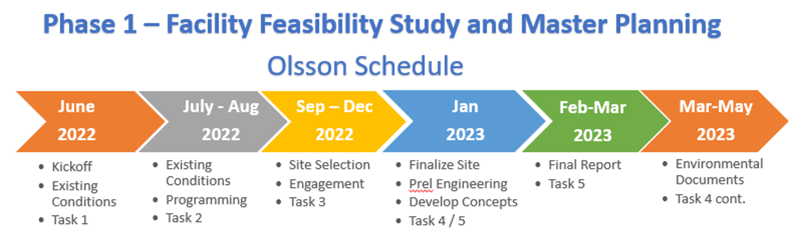
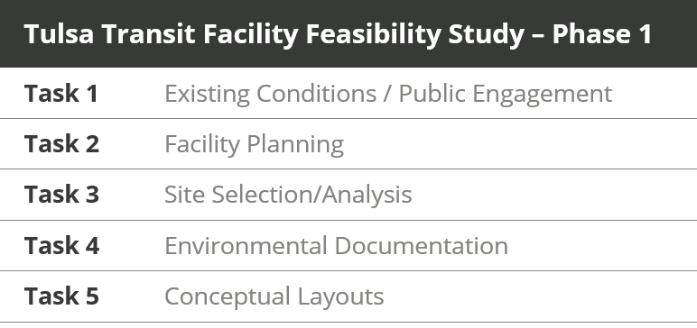
TASKS / TIMELINE – Facility Project
CONNECTS PEOPLE TO PROGRESS & PROSPERITY

Slide 7
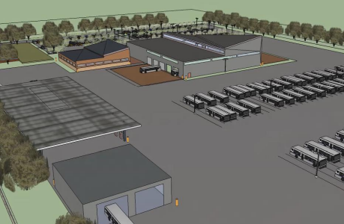
TULSA TRANSIT FACILITY – VISION
Goals for the Facility
  Meet the needs of the Admin, Operations, and Maintenance departments that will be located at the site though maintenance spaces, administrative support, employee service areas, and vehicle parking
  Provide a functional flow between facilities, parking, and throughout the yard
  Comply with all building and design standards and regulations, including ADA
  Provide safe and efficient circulation for vehicles on site
  Provide an effective layout with opportunity for future expansion
Needs
Sept Site Visit – Data Collection
  Met Directors and 7 Departments
  Project Team
  Existing / Future Needs
Data Analysis – Future Site Size
CONNECTS PEOPLE TO PROGRESS & PROSPERITY

Slide 8
Facility Project - Task 1 and 2
Sept Site Visit – Data Collection
  Met Directors and 7 Departments
  Project Team
  Existing / Future
Data Analysis – Future Site Size
CONNECTS PEOPLE TO PROGRESS & PROSPERITY

Slide 9
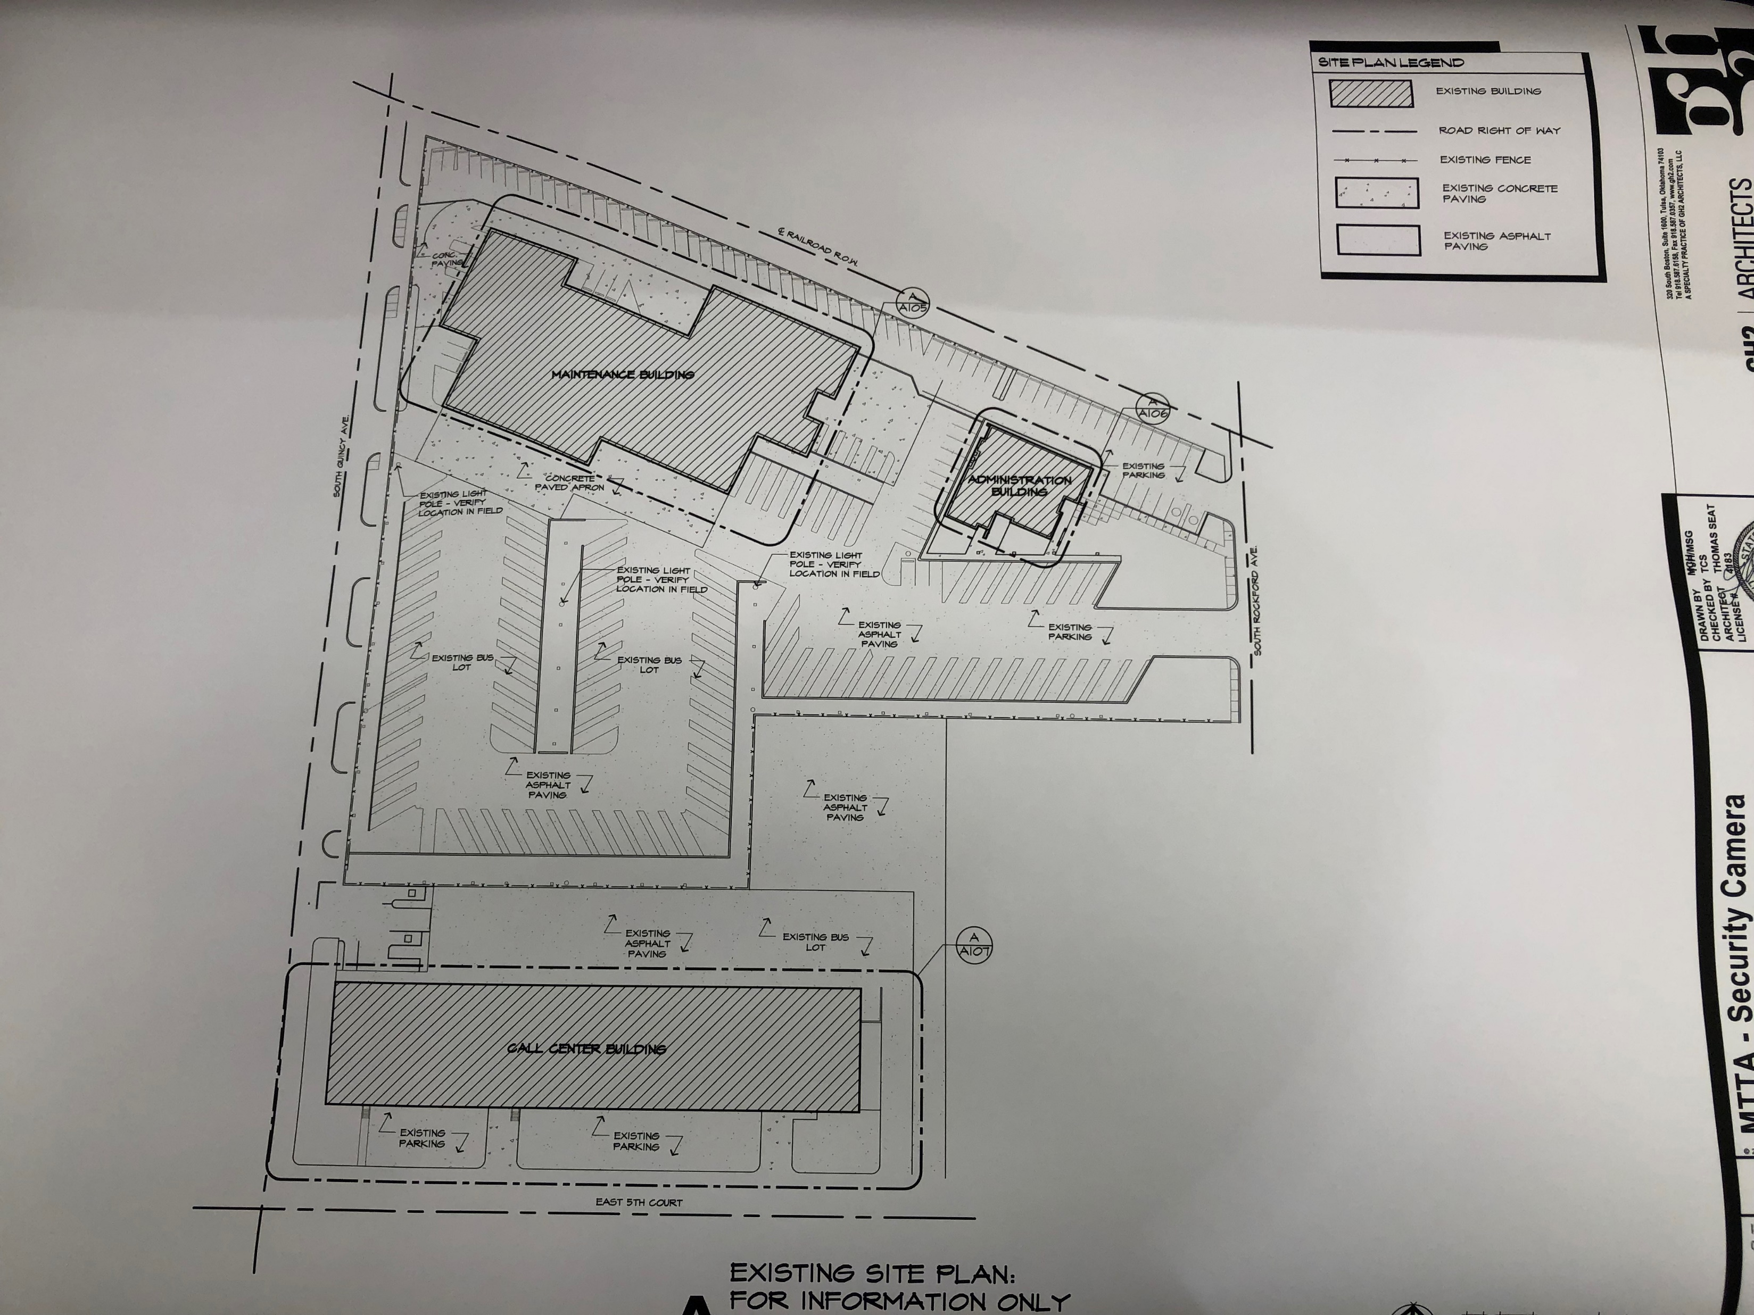
Existing Site
Existing site = 5 acres
  Does not include all employee parking
Total 134 vehicles today – all services
  Growth
  Make room for LT Plan/Growth/Phases
40-yr Facility Life – based upon data received
  150 + vehicles – 5-10 yrs (12%)
  200 vehicles – 20 yrs (33%)
  250 vehicles + – 40yrs (25%)
CONNECTS PEOPLE TO PROGRESS & PROSPERITY

Slide 10
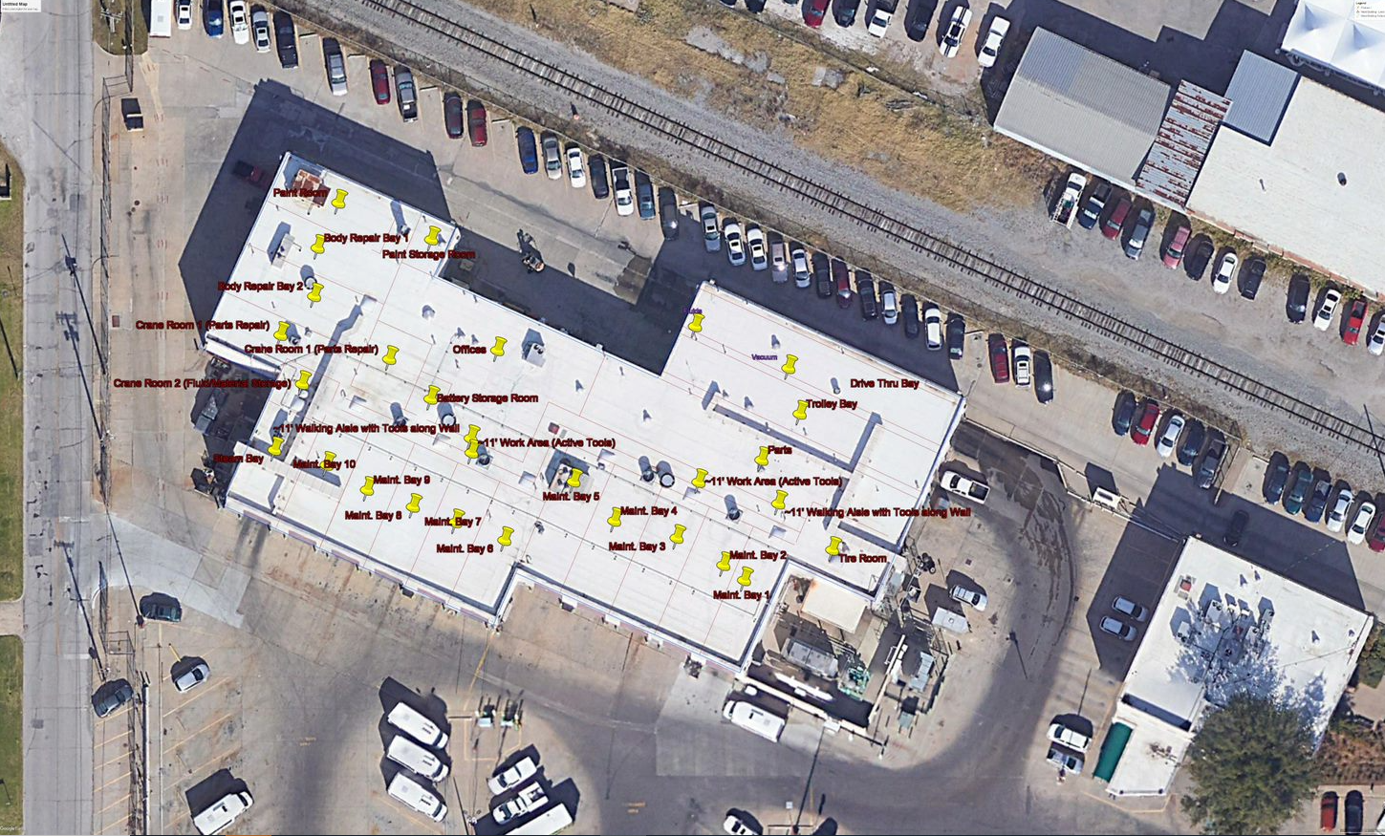
Maintenance Facility
CONNECTS PEOPLE TO PROGRESS & PROSPERITY

Slide 11
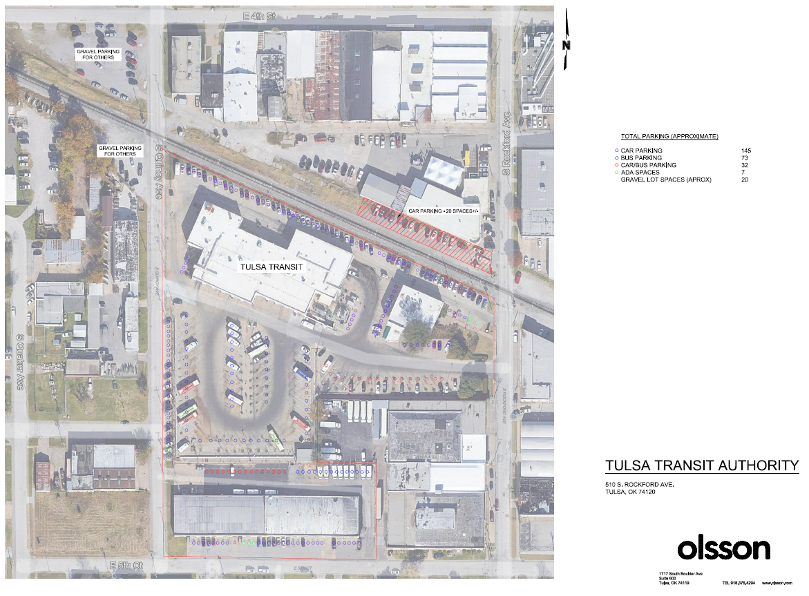
Existing
Parking
+/- 275 spaces
CONNECTS PEOPLE TO PROGRESS & PROSPERITY

Slide 12
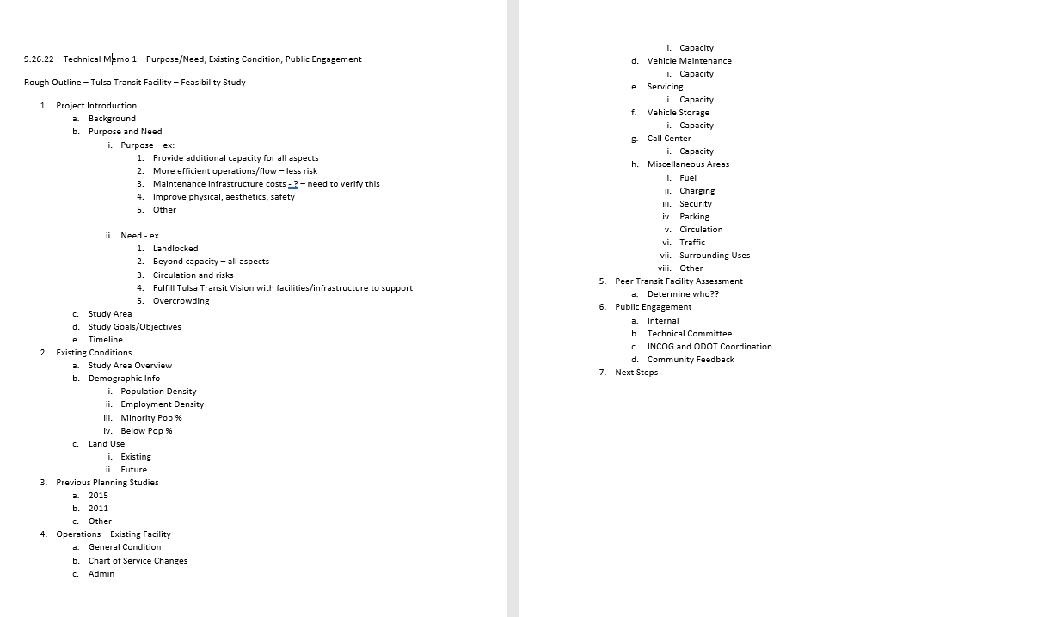
Tech Memo Outline
Next Steps
CONNECTS PEOPLE TO PROGRESS & PROSPERITY

Slide 13
Facility Program – 2 Methodologies
Programming Methods – High Level
APTA A/E Design for Transit Operating and Maintenance Facility
FTA Recommended Facility Program Elements
Next Steps – Refine Olsson/GH2
  CDL Training Area
  Detailed review of spaces to refine square footage of buildings
CONNECTS PEOPLE TO PROGRESS & PROSPERITY

Slide 14
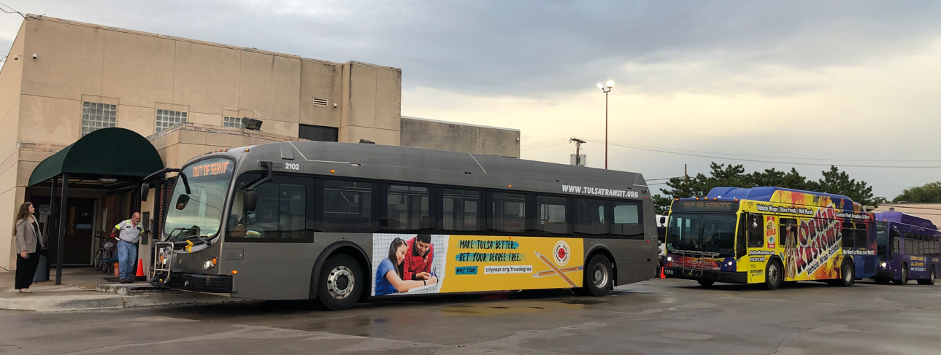
Develop Site Criteria – Level 1
High Level Screening – Show Stoppers – Pass/Fail – Carry Forward
  Acreage/Size - City owned properties under 5 acres
  Flood Plain – Y/N
  Known Environmental Concerns – Y/N
  Availability
  Land Use/Zoning – Existing/Future
  Transit Route Proximity – Location
  Access to Major Roadway
CONNECTS PEOPLE TO PROGRESS & PROSPERITY

Slide 15
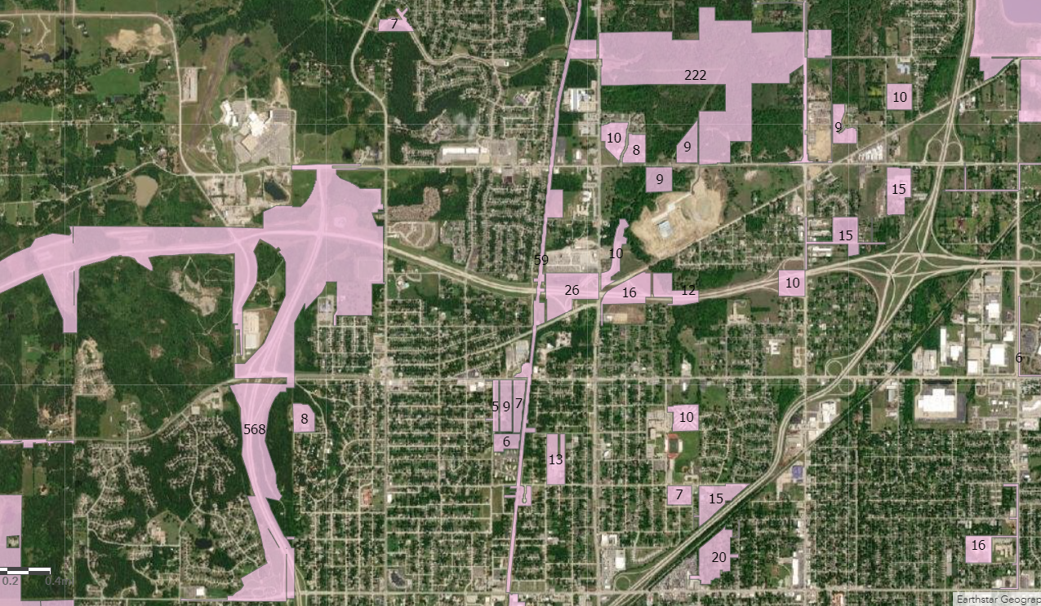
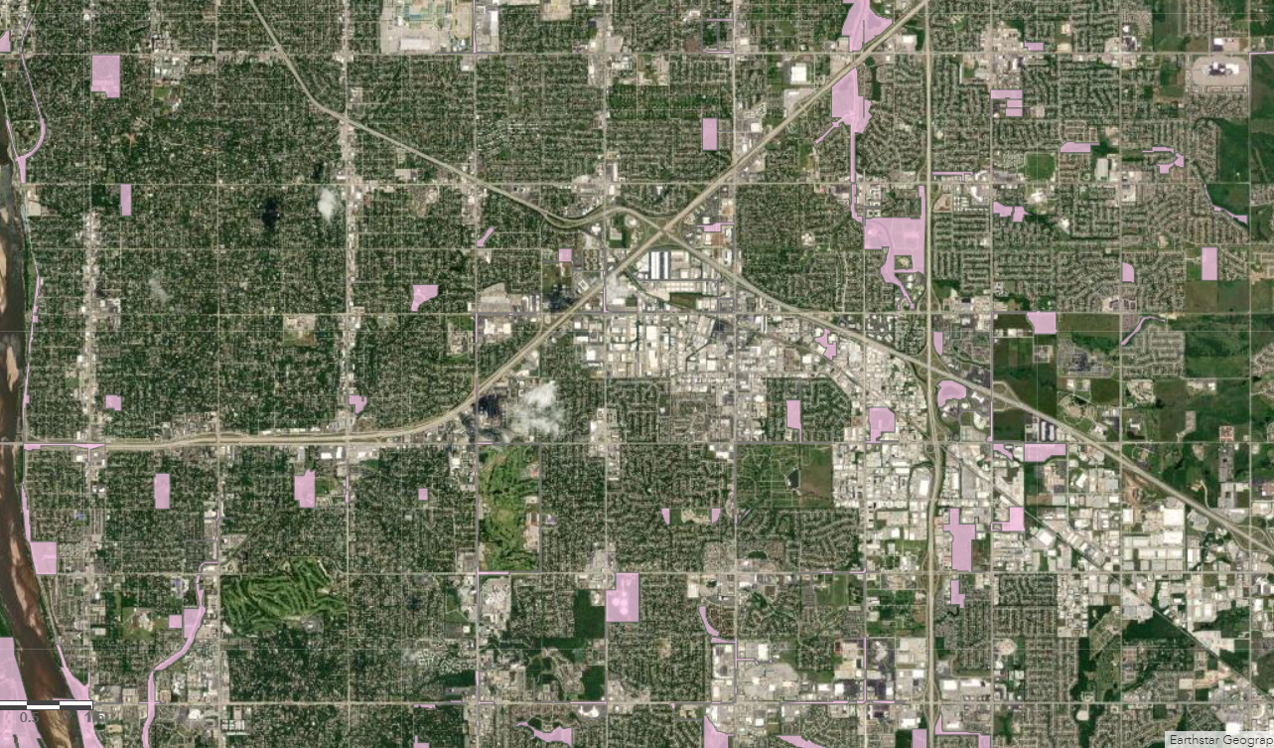
Develop Site Criteria – Level 1 Screening
High Level Screening – Show Stoppers – Pass/Fail – Carry Forward
City owned sites – over 5 acres – over 100 properties
Carry forward city-owned sites over 15 acres
CONNECTS PEOPLE TO PROGRESS & PROSPERITY

Slide 16
Develop Site Criteria – Level 2 Screening
Level 2 Screening – More Detailed Analysis
  Site Size
  Location
  Availability - Ownership
  Land Use Compatibility
  Proximity to Transit Routes
  Parking
INITIAL SITE OPTIONS ……..
7 Sites – Moved to Level 2 Screening
Environmental, cultural, historical concerns
Access to site
Appraisal information – Cost
Utilities - Water/Sewer/Electric/Gas Available
Vacant
CONNECTS PEOPLE TO PROGRESS & PROSPERITY

Slide 17
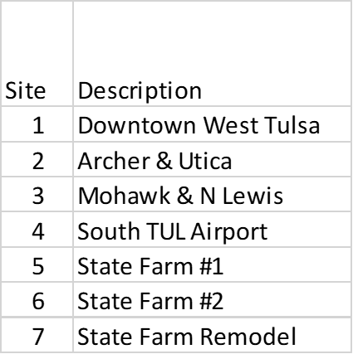
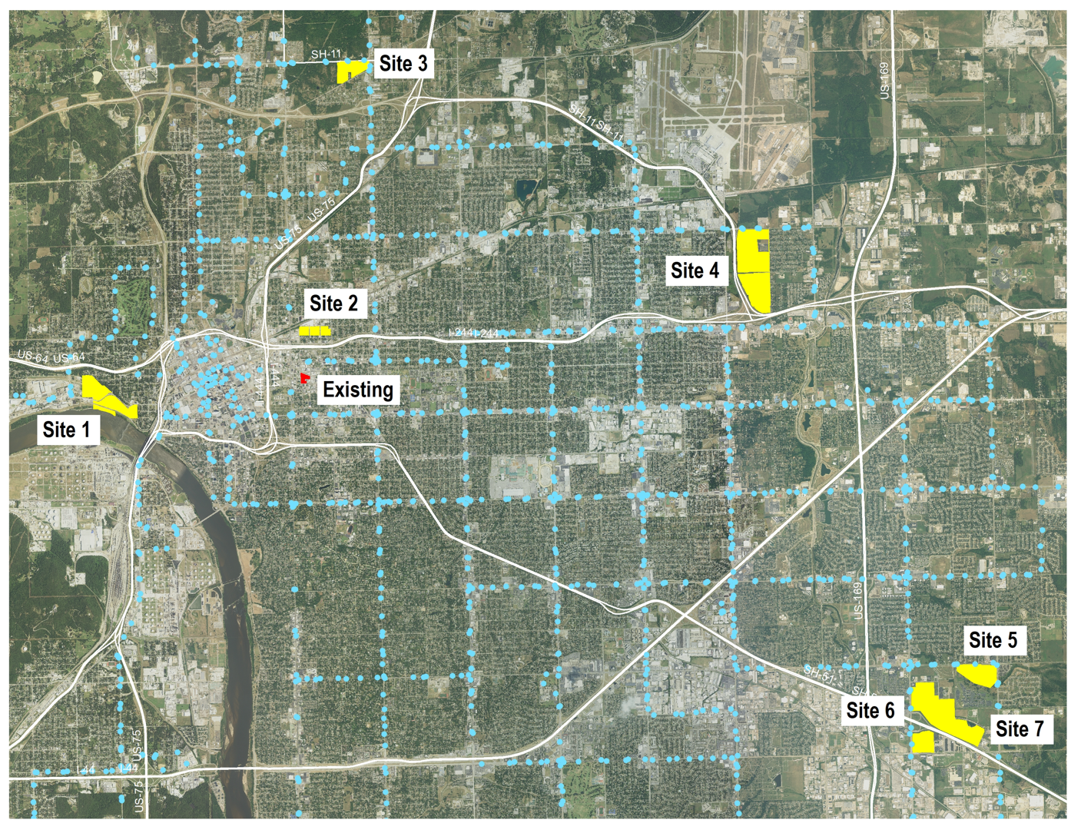
Develop Site Criteria – Level 2 Screening
Site Characteristics – Level 2
Address
Acreage (Size)
Ownership - Availability
Parcels
Land Use Compatibility
Proximity to Transit Routes
Environmental, cultural, historical concerns
Access to Site
Appraisal Information
Utilities (Water, Sewer, Electric, Gas, etc.)
Vacant
Flood Plain
CONNECTS PEOPLE TO PROGRESS & PROSPERITY

Slide 18
Site Selection Process – Next Steps
Feedback on 7 Sites – Propose Other Sites – Criteria Suggestions
  Technical Committee
  Public Open House
  Local Project Team
Rank ALL Sites
CONNECTS PEOPLE TO PROGRESS & PROSPERITY

Slide 19
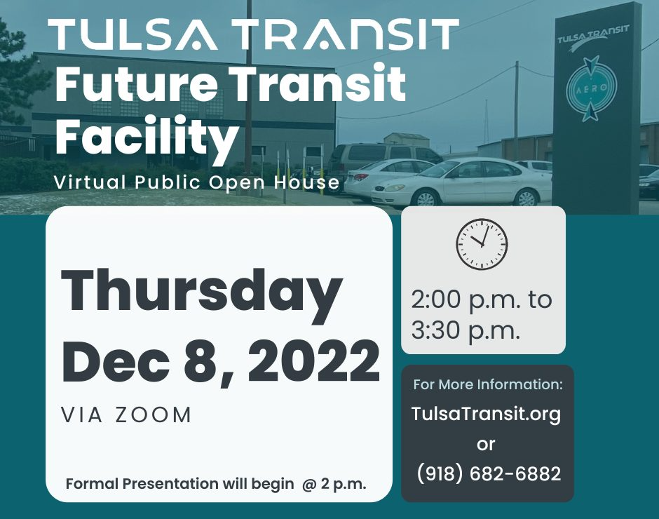
Discussion / Questions
Questions:
  FTA Feasibility Study Process
  Initial Sites
  Other
Suggestions of Other Potential Sites
Other Questions
CONNECTS PEOPLE TO PROGRESS & PROSPERITY

Slide 20
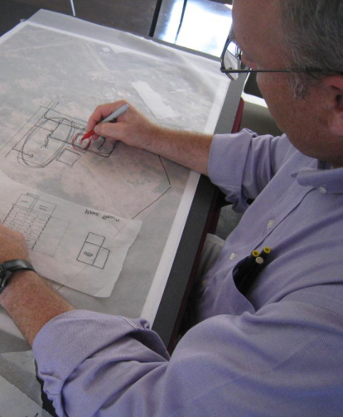
Lots More To Do
PROGRAMMING
Refine estimates for building
SITE SELECTION
Continue Data Collection on 7 sites
Finalize Level 2 Screening
More analysis on City/County Data
ENGAGEMENT
Public Open House
  Materials/ppt
Board Meeting
Technical Committee Meeting – January
Outreach to FTA
Other
                DISCUSSION / THANK YOU
CONNECTS PEOPLE TO PROGRESS & PROSPERITY

