Slide 1
12.09.2021
MTTA
Microtransit Pilot Public Meeting

Slide 2
Agenda
House Rules
Meeting Purpose and Goal of the Project
What is Microtransit?
Microtransit Zones
Feedback
Question & Answer Time
Project Timeline and Next Steps
NOTE: Meeting is being recorded

Slide 3
House Rules and How to Ask a Question
Please keep yourself on mute until the Q&A session
Please hold questions until the Q&A session
Please keep questions relevant to the meeting topic of Microtransit
Use the chat and/or ‘raise hand’ feature if you need clarification on a slide
Please be mindful of time to make sure everyone can be heard
If you are joining by phone, email questions to info@tulsatransit.org

Slide 4
Project Goal and Meeting Purpose
Goal of the Pilot
Better serve Tulsa Transit rider markets where there is low ridership demand:
Nightline and Sunday Routes,
Workforce Express Network, or
Broken Arrow Route 508
Meeting Purpose
Inform public on what microtransit service is and what the microtransit service experience would be like
Gain public feedback on pilot microtransit service areas considered
Notes:
Liann’s slide

Slide 5
What is Microtransit?

Slide 6
What is Microtransit?
Passengers request rides on their smartphones or by calling the transit agency, and scheduling software then optimizes a microtransit vehicle’s route in real time to serve requests with a solo-ride or small carpool.
Wait times are close to 15-20 minutes between ride request and pick-up
No need to call a day or hours in advance
Available to use by anyone requesting a ride within the microtransit zone
Bus
Photo: Via microtransit service, West Sacramento, CA
Notes:
Somewhere in between more demand responsive than fixed route transit but not as responsive as individual requests (the traditional model of taxis or TNCs)
This middle ground is defined as one in which passengers crowdsource minibus and van rides by requesting rides on their smartphones through an app. Scheduling software then optimizes the vehicle’s route in real time to serve the most amount of people as efficiently as possible.
less a completely new mode than an evolution of existing modes enabled by technology. SAE International broadly defines microtransit as “a privately or publicly operated, technology-enabled transit service that typically uses multi-passenger/pooled shuttles or vans to provide on-demand or fixed-schedule services with either dynamic or fixed routing
Typically funded by transit agency to keep fares low

Slide 7
What is Microtransit?
Microtransit functions best within a defined zone of service
ZONE
OUTSIDE ZONE AREA

Slide 8
What is Microtransit?
On-demand service in coverage area:
serve one or a few origins to one or a few destinations with routing determined by demand
serve a few origins to a hub or transfer point with routing determined by demand
ZONE
ZONE
Notes:
Explain that microtransit service functions best through operation in a zone
Can operate as feeder service to transit network through scheduled connections
Coverage area: geography within which the service operates. Since most microtransit service designs involve flex routes, the coverage area limits the maximum possible length of a trip
A hub is a fixed origin or destination, usually near a high demand residential, commercial or institutional use. It can also serve as a transfer point from zone to zone or from zone to a fixed route transit service.

Slide 9
What is Microtransit?
“Curb to curb” or “Door to door”
vs.
Pick up location/drop off
Notes:
Curb-to-curb: vehicle arrive at the trip origin and end at the requested destination within the ROW. (‘door to door’ is not used to distinguish it from service provided by some human service operators)
Virtual: dispatching software allows the operator to create an efficient route to multiple origins and destinations. From there, the operator may, through a location-aware mobile app, direct users to pick-up locations and set dropp-off locations within a reasonable walking distance of origins and destinations. Increases vehicle utilization (efficiency?)

Slide 10
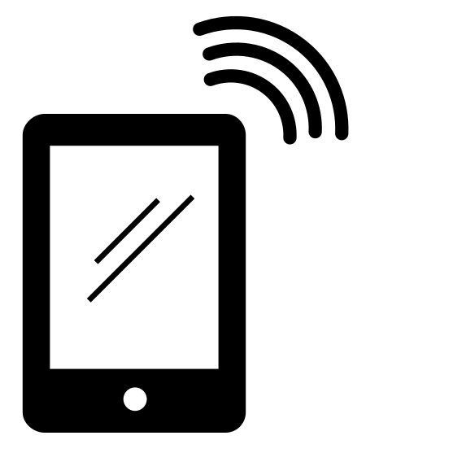
Customer experience: requesting a ride
1. Ride Request
2. Routing
3. Arrival Notifications
4. Pick Up
Graphic credits: Yeoul Kwon, stephanie wauters, Mr bOZO and icon 54, Noun Project
Notes:
Accommodations for those with disabilities – reiterate that a call can be made. Notifications can be made via text or on a regular landline.
The apps are designed to be accessible for those that have difficulty seeing.
Someone who is deaf could use a TDY line or rely on the app visuals

Slide 11
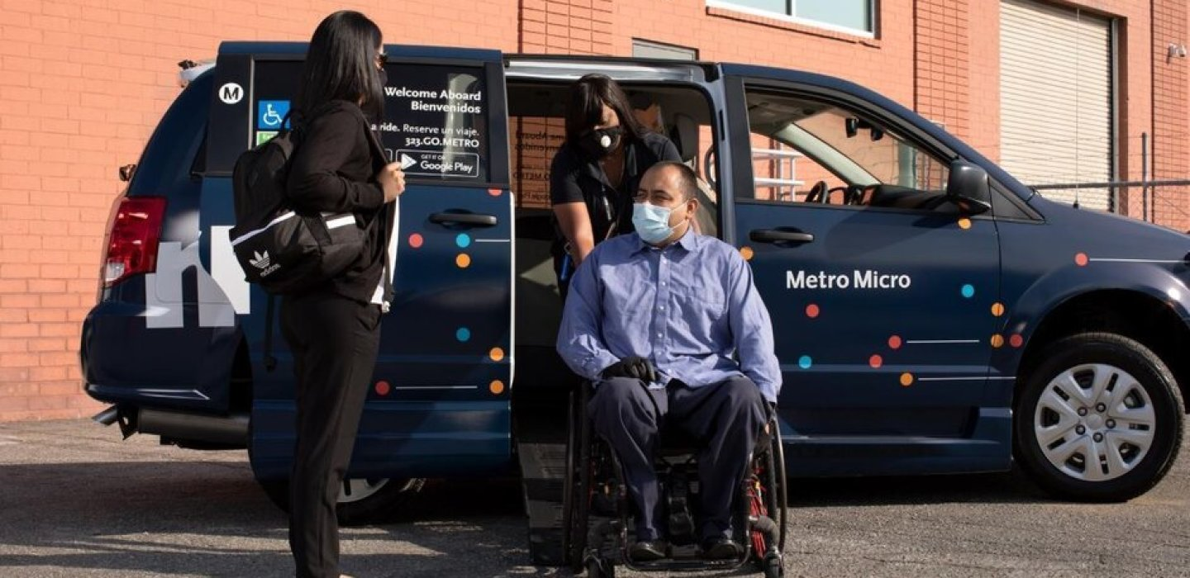
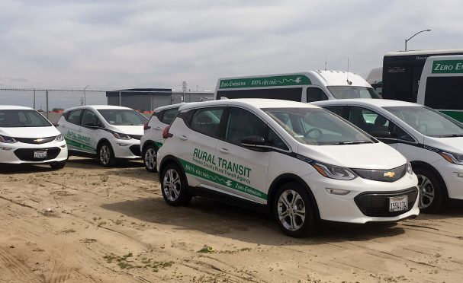
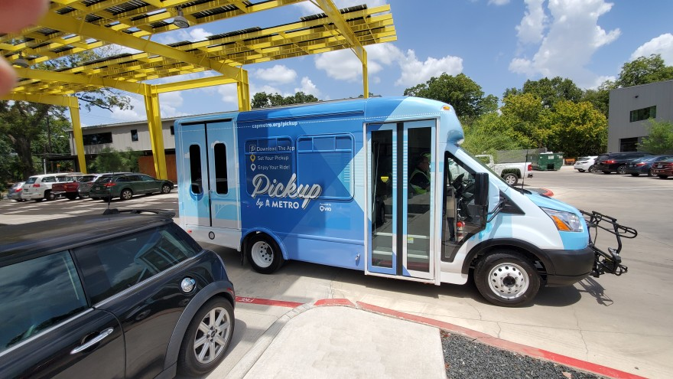
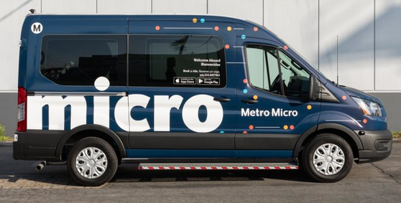
Customer experience: vehicles
Notes:
Cutaway: In these heavy-duty shuttle vehicles, a van cab and chassis remain, while the remainder of the body is modified for transit use, with capacity for upwards of 20 passengers. Often used for ADA paratransit and human services transportation, these vans can be re-branded to use as microtransit with little modification.
Passenger vans: These tend to be the larger-height vans popularized in Europe, with capacities of 10-15 passengers. The vans can be modified to include lifts to include all passengers.
Minivan: These vehicles typically hold 4-6 passengers, or if the vehicles are wheelchair-accessible, a single wheelchair-using passenger plus one non-wheelchair-using passenger.
Size fits demand
Size is more adaptable to neighborhood street sizes
More fuel efficient and less costly to operate – all electric options
Can be shared across services such as paratransit

Slide 12
Why Invest In Microtransit?
Better serve low demand areas for the cost of providing service
Evolve with customer expectations
Better technology and more industry experience
Notes:
Hold ourselves to a good standard of service.
Why is Tulsa Transit looking at this now? Many cities have tested this service and the technology and choices for vendors makes it a possibility

Slide 13
Questions on What Is Microtransit?

Slide 14
Microtransit Zones
Notes:
Remember that Microtransit is a zone based-service and we needed to develop zones for consideration.

Slide 15
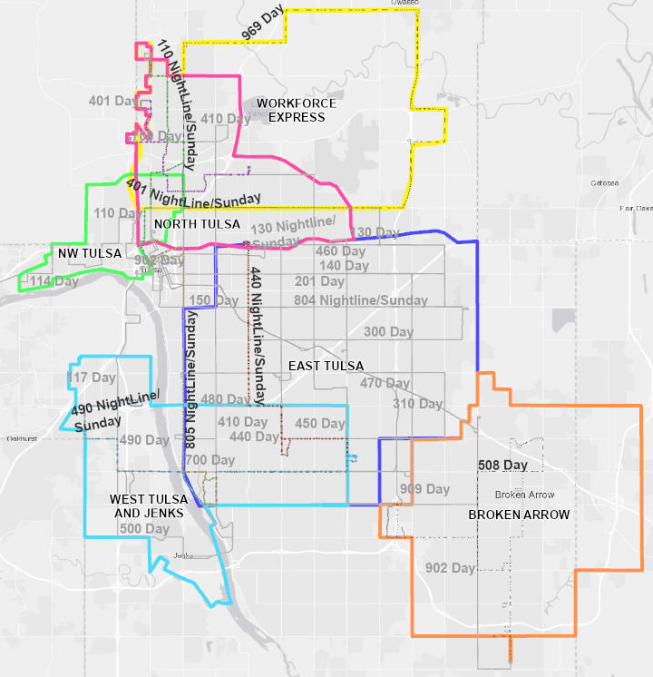
Microtransit Zones Overview
Initial evaluation of 6 zones
Low ridership demand
Night Line/Sunday
Workforce Express
Broken Arrow
Higher need
Food desert, public housing, large employer access and low income
Method for drawing zone boundaries
Balance of transfers to transit service and destinations inside the zone
Customer convenience
Wait times of ~15 mins.
Intuitive zone boundaries
Prioritize City of Tulsa corporate boundaries for pilot (but may add other jurisdictions for future pilots or service)
Downtown Tulsa
Notes:
Daytime Service: ~5:30am – ~8:30pm
Night Line Service: ~8pm-~midnight
Workforce Express has two morning (before 5am) and two evening trips
Proposed zones for discussion
Six pilot areas
May not need to include all, but we cast a wide net in serving all areas currently connected by Night Line or known low ridership areas – Broken Arrow and Workforce Express
May use a phased approach
Zones focus on transfers to BRT unless it is too inconvenient. Otherwise can be used for internal circulation, which helps dictate how large the zone area is

Slide 16
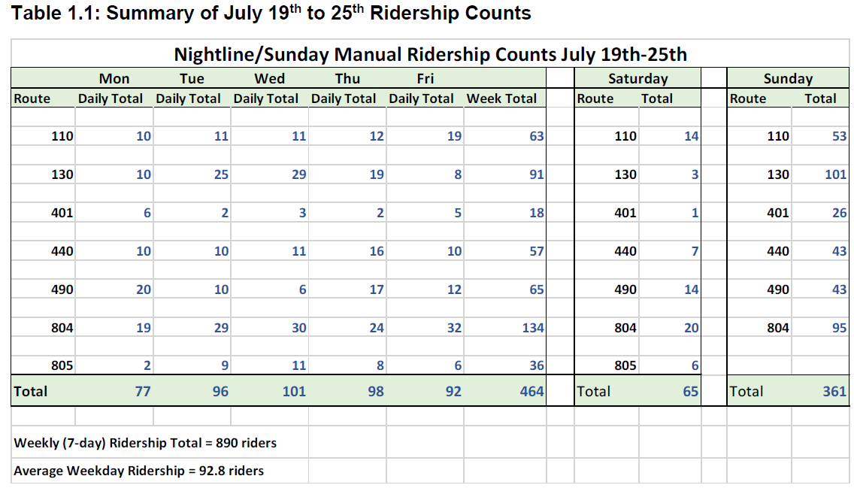
Ridership
Source: July 2020 Ridership Counts, IBI Group, Evaluation and A Way Forward Study
Notes:
Location: Low demand or low density

Slide 17
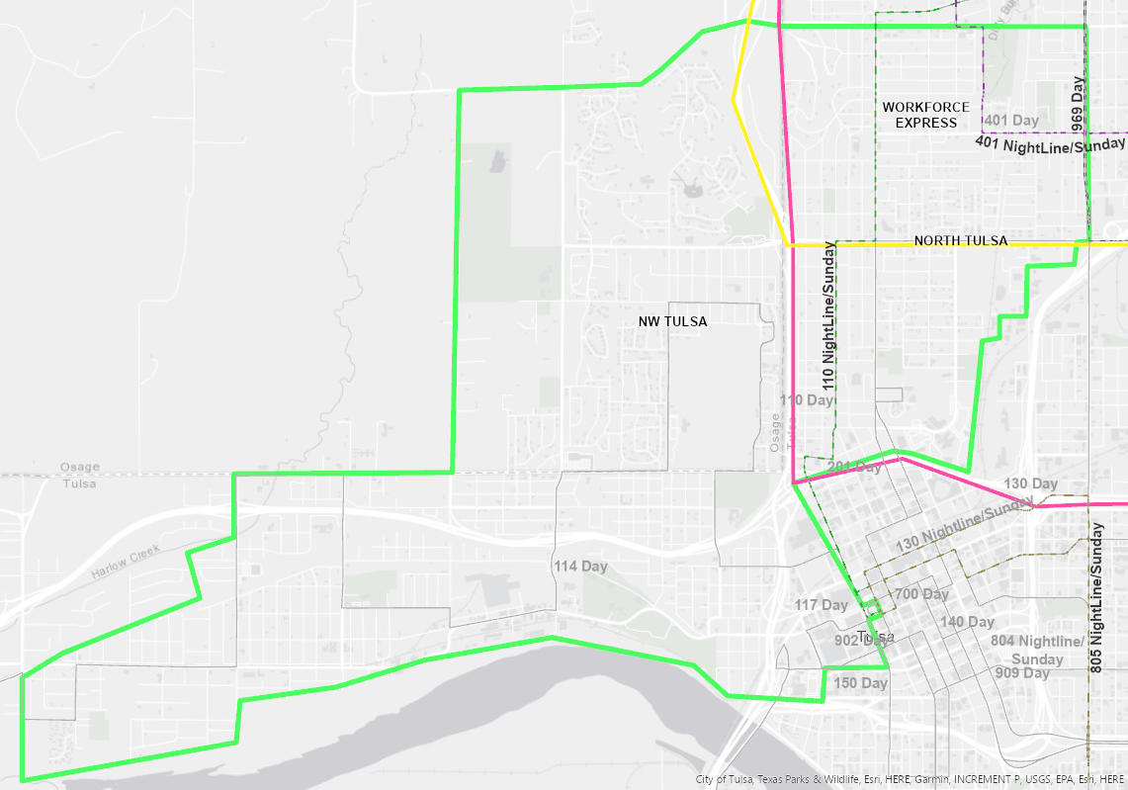
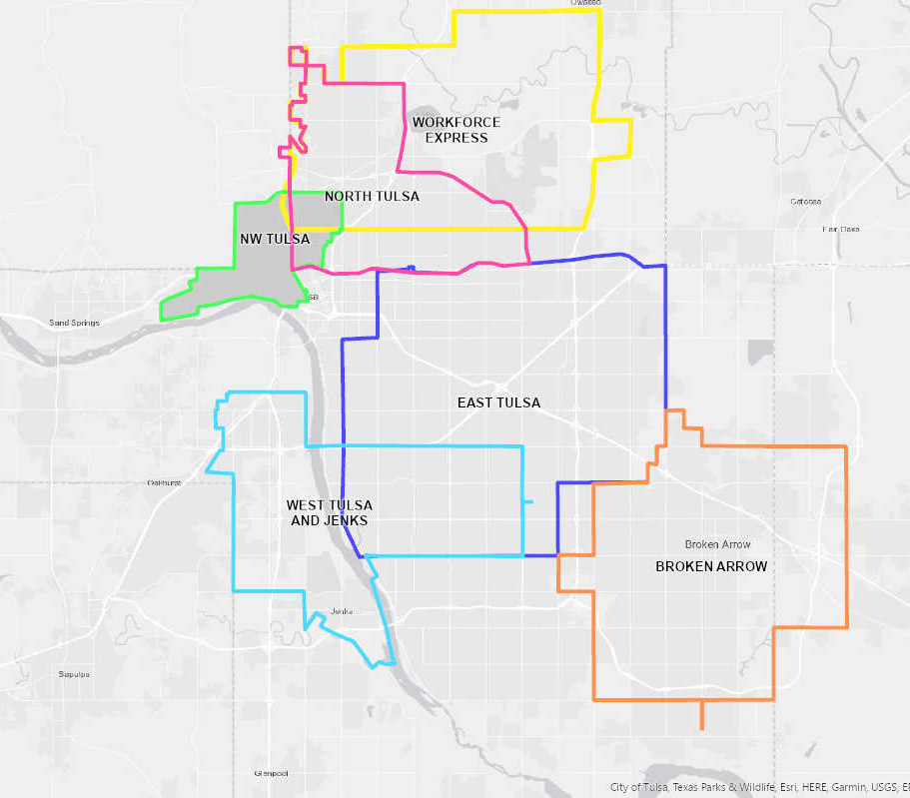
NW Tulsa
Direct service to downtown or transfer to Peoria BRT
Replaces Night Line Route 110 (~13 daily riders*)
*Mon-Sat
Notes:
Ridership source: July 2020 Ridership Counts prepared by IBI Group from Evaluation and A Way Forward Study
Proximity to downtown makes sense for one seat ride (versus passing it to get to BRT route)
Transfer to Denver Ave Station

Slide 18
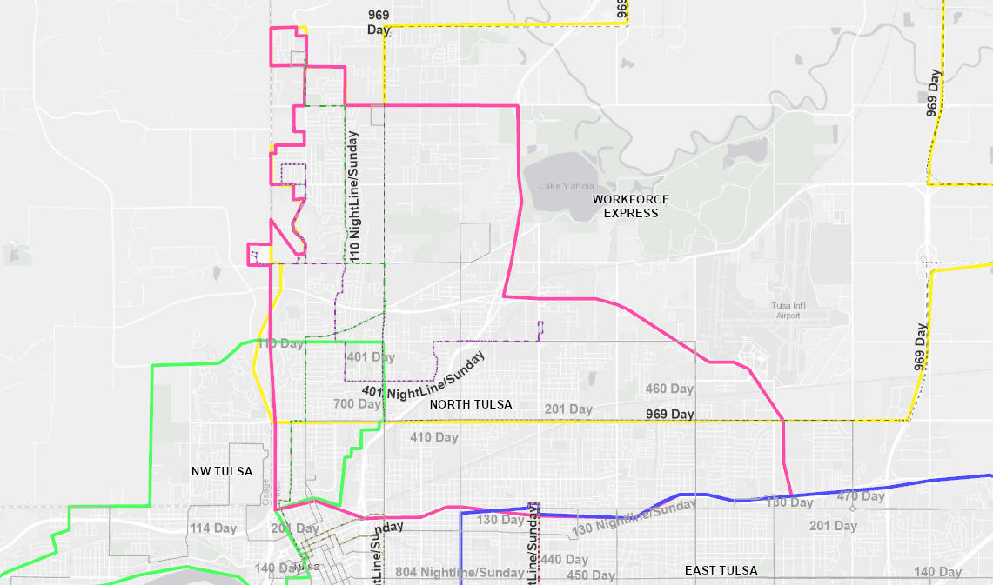
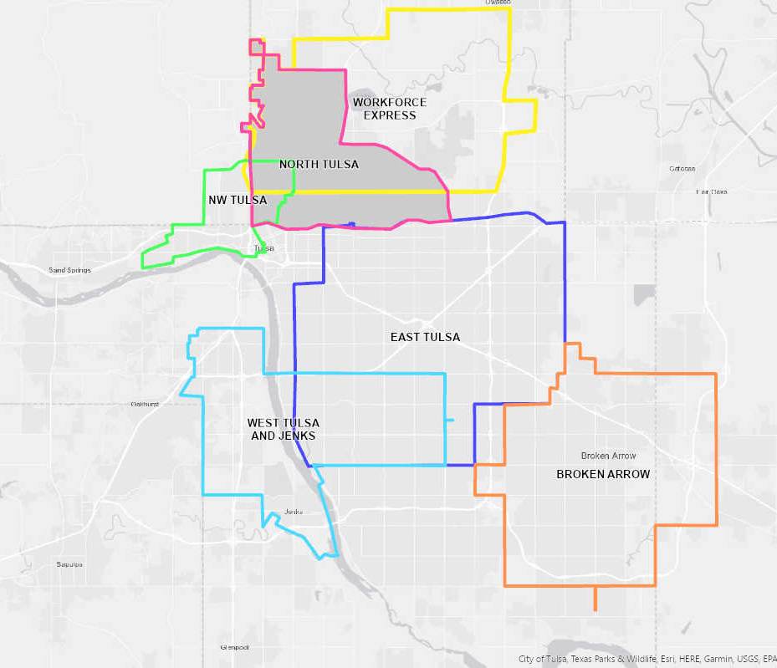
North Tulsa
Service to Peoria BRT
Replaces Night Line Routes:
110 (~13 daily riders)
401 (~3 daily riders)
Includes airport terminal

Slide 19
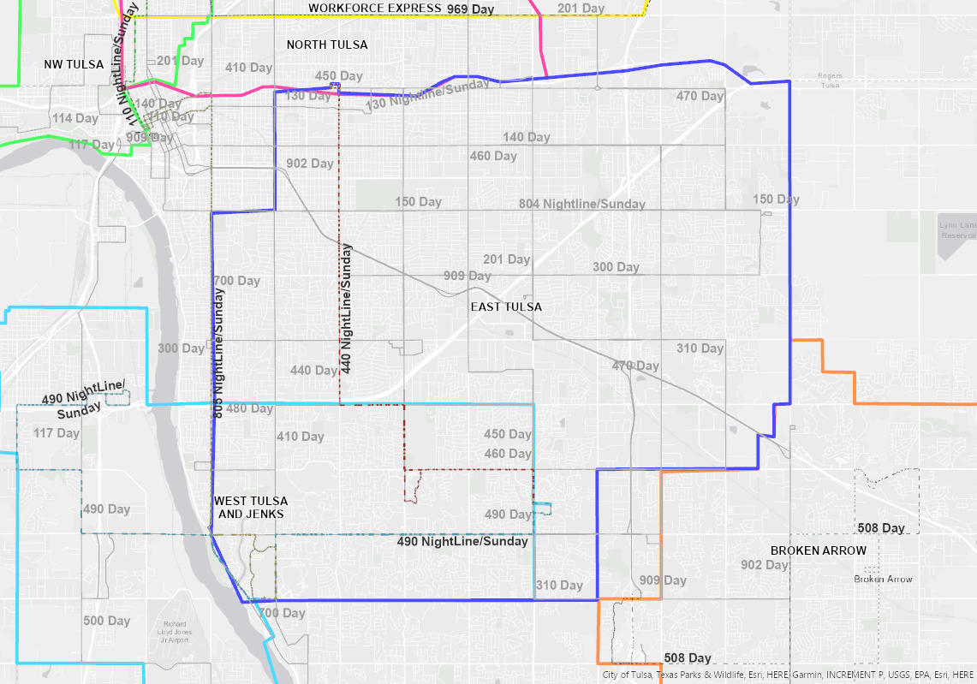
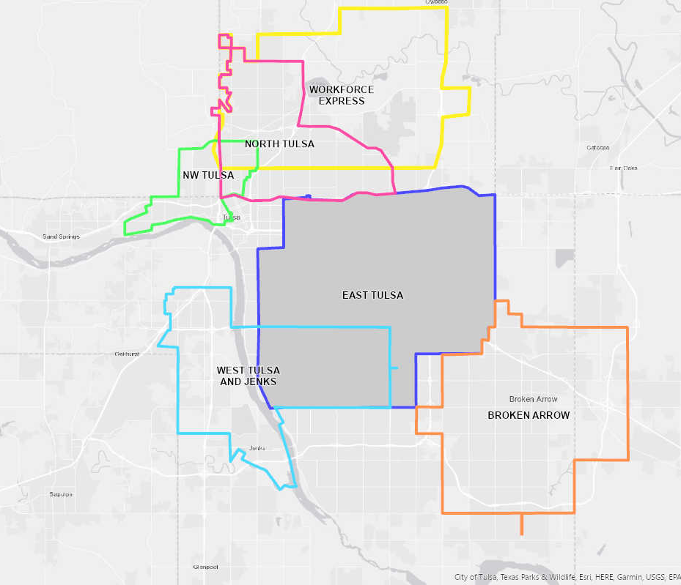
East Tulsa
Service to Peoria BRT
Replaces Night Line Routes:
440 (~11 daily riders)
Revised 490 (~13 daily riders)
Future connection to Route 66 BRT service
Potential revision into two zones
Notes:
Consider transfer points with greater passenger amenities
Include route starting point in order to reduce passenger stress regarding reliability if they know when the bus leaves the first boarding station
Zone overlap on the south accounts for potential internal circulation with destinations along 71st, 81st and 91st arterials (schools, grocery stores) that can be afforded while still upholding ideal wait time for passengers
Include a destination for Saint Francis Hospital?

Slide 20
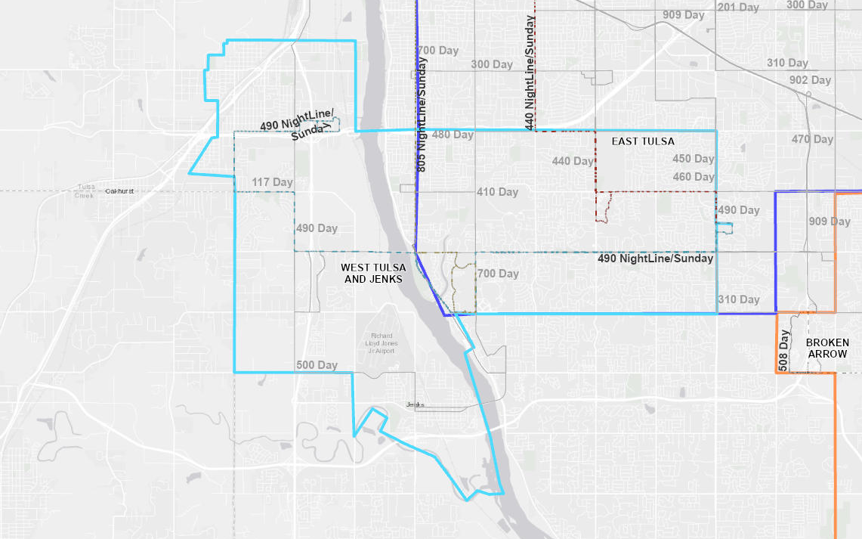
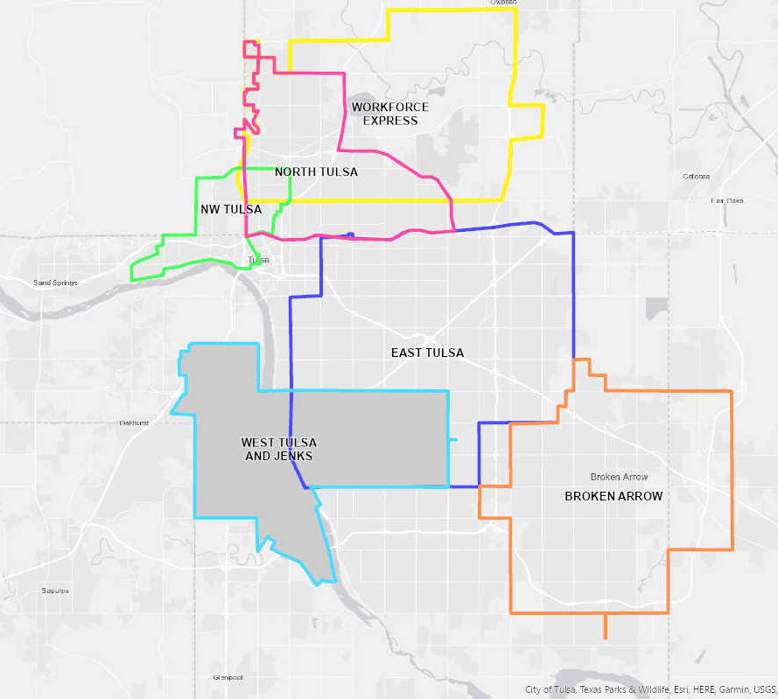
West Tulsa and Jenks
Service to Peoria BRT
Replaces Night Line Route 490 (~13 daily riders)
Includes portion of Jenks
Notes:
Jenks is not in the night line service, but the 490 service is very low performing
We are talking to Jenks about their service as part of the Cost Allocation project

Slide 21
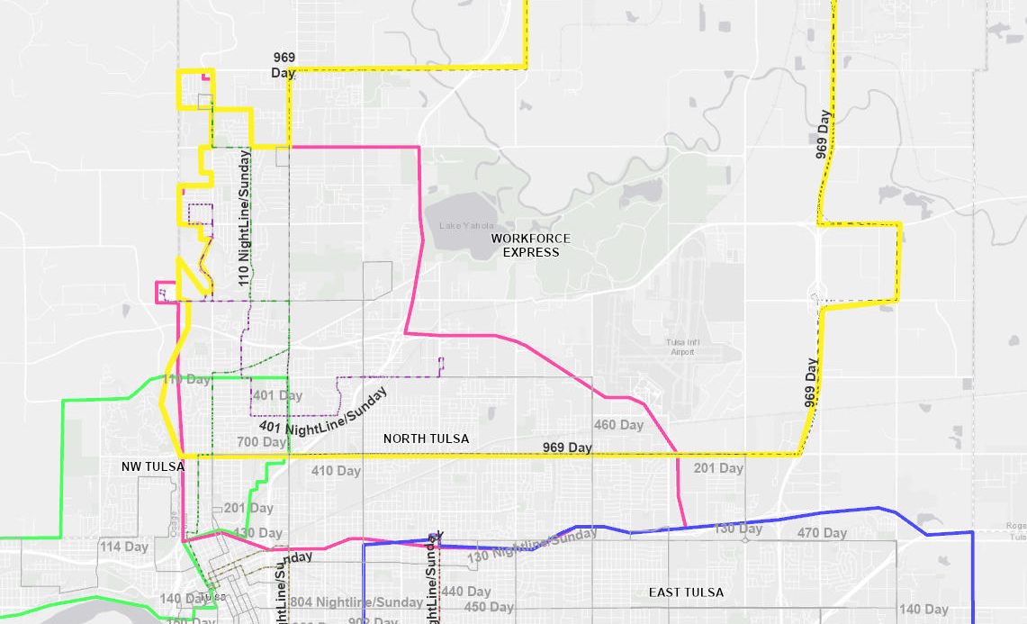
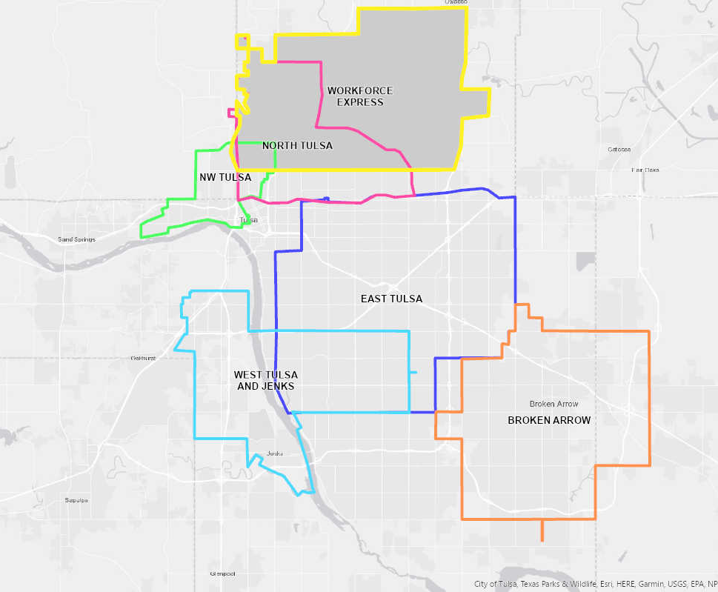
Workforce Express
Capture worker origins for access to major employers and transfers
Replaces Workforce Express Network Route 969 (max. of 16 daily riders since Oct ‘20) and updates span of service
Connections to Routes 110, 201, 410, 460, Peoria BRT
Notes:
November 2020 was the highest ridership (328 riders in the month) on record between October 2020 and September 2021. Confirm that the service is weekdays only
Started by Tulsa Transit at the request of employers to provide access to that part of the metro area

Slide 22
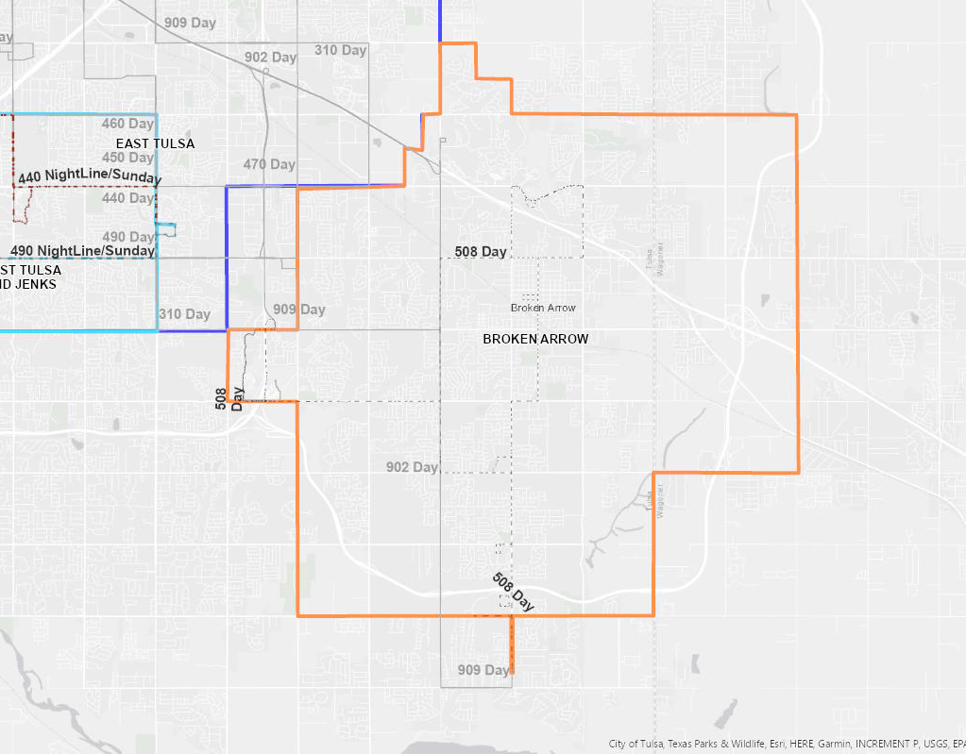
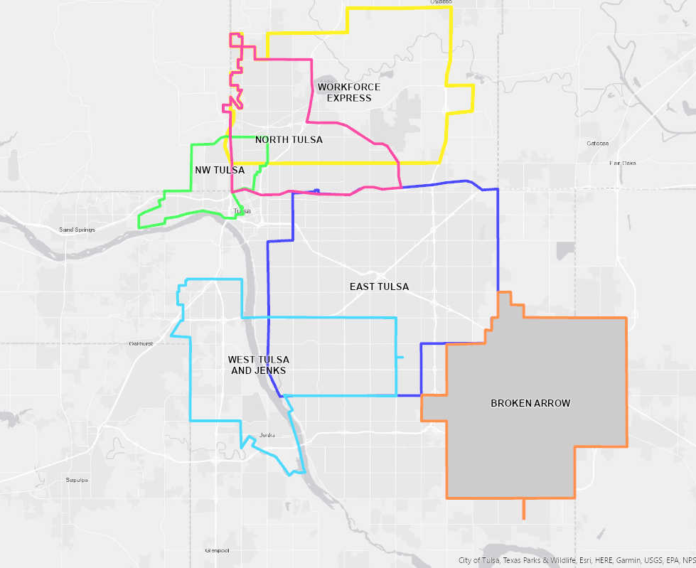
Broken Arrow
Internal circulation for Broken Arrow residents plus transfers
Replaces Route 508 (~27 daily riders, Mon-Fri)
Includes Park and Rides for Routes 902, 909 and transfer to 310
Connection to Sub-hub?
SUB-HUB
Notes:
Ridership source: Olsson, Inc., Broken Arrow Transit Study February 2021. 7000 annual riders

Slide 23
Feedback

Slide 24
Feedback
http://tiny.cc/microtransit_feedback
Notes:
http://tiny.cc/microtransit_feedback

Slide 25
Question and Answer Time (Q&A)

Slide 26
Project Timeline and Next Steps

Slide 27
Ways to Ask or Comment After the Meeting
Feedback tool: http://tiny.cc/microtransit_feedback
Email Tulsa Transit: info@tulsatransit.org
Call Tulsa Transit: 918-582-2100

