Slide 1


Slide 2


APRIL SERVICE CHANGES
EFFECTIVE SUNDAY, APRIL 12TH
Route 250 routing & timing
Route 470 routing & timing
New daytime MicroLink Zone 9
Kickoff New Bus Stop Pairing Project starting with Routes 110 and 117

Slide 3
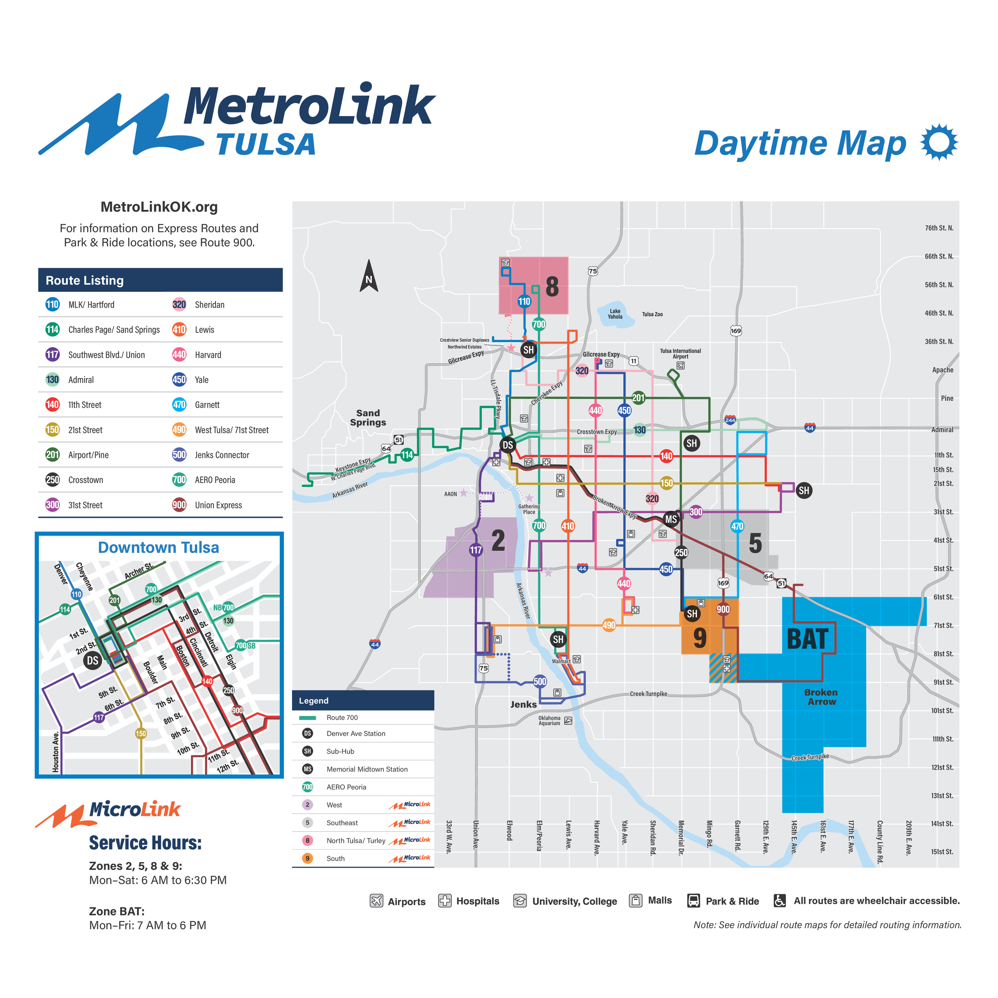
DAYTIME

Slide 4
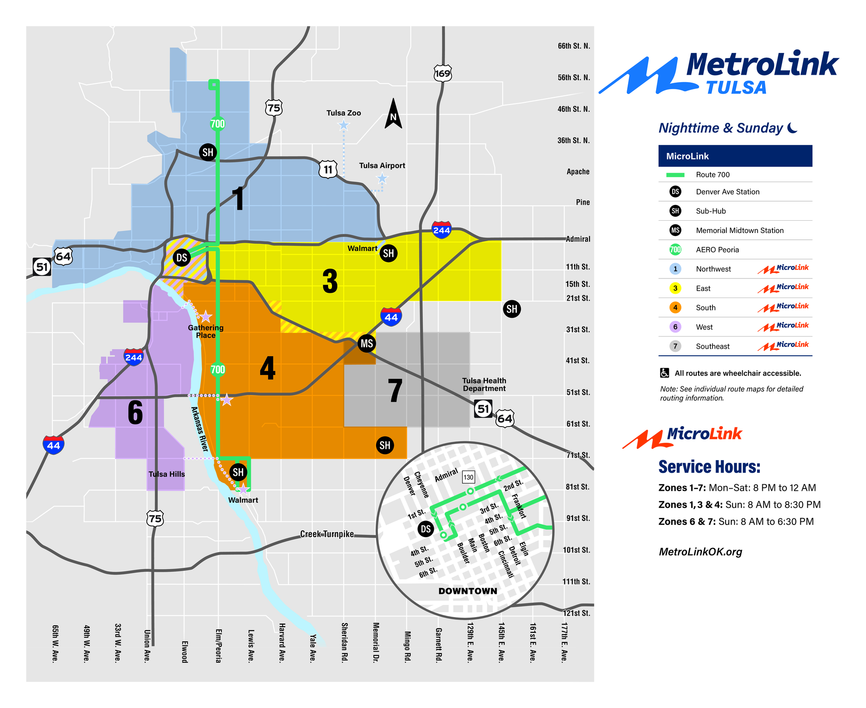
NIGHTTIME

Slide 5
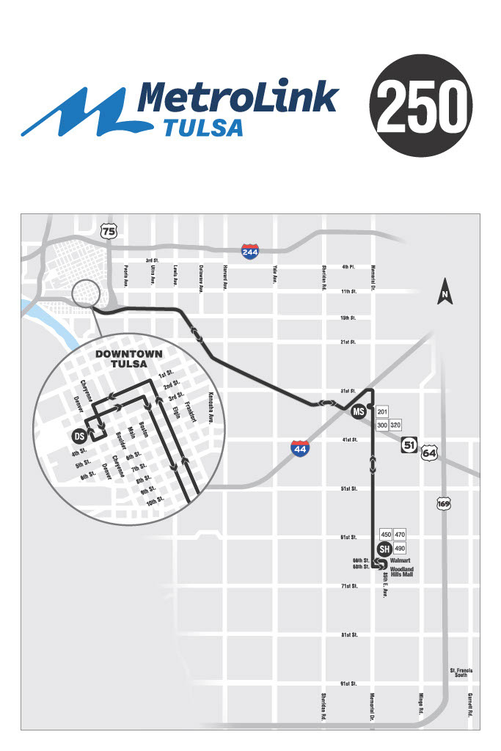



250 CHANGES
Route will end at the Woodland Hills Sub-hub.
New frequency
Weekday is 30 min
Saturday is 45 min

Slide 6
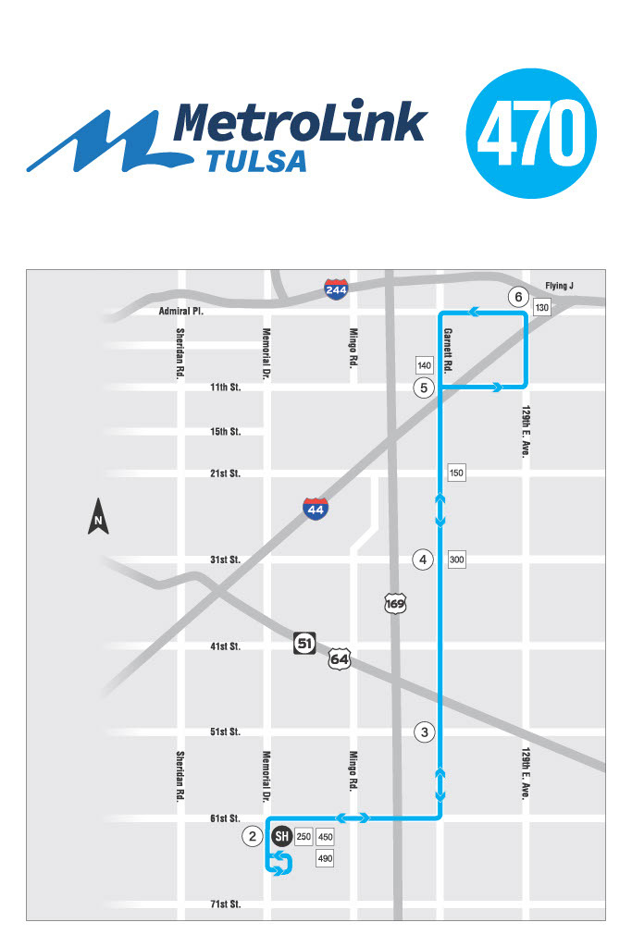

470 CHANGES
Will travel 61st St between Garnett and Memorial
New frequency weekdays & Saturday is 40 min.

Slide 7

MICROLINK ZONE 9 SOUTH
New MicroLink Daytime zone.
Connects to BAT
Will service TCC SE, St Francis South, The VA Medical Center

Slide 8

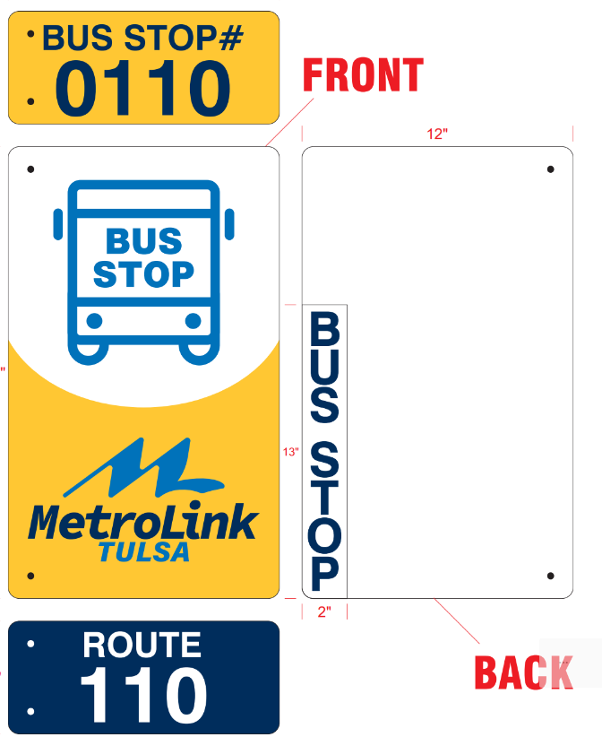
BUS STOP PAIRING PROJECT
Starting with Routes 110 and 117
Implementation of the newly designed and branded bus stop signs
Enhances safety and accessibility where possible
Increases service efficiency by consolidating close proximity stops and low-usage stops
Improved rider experience for return trips

Slide 9
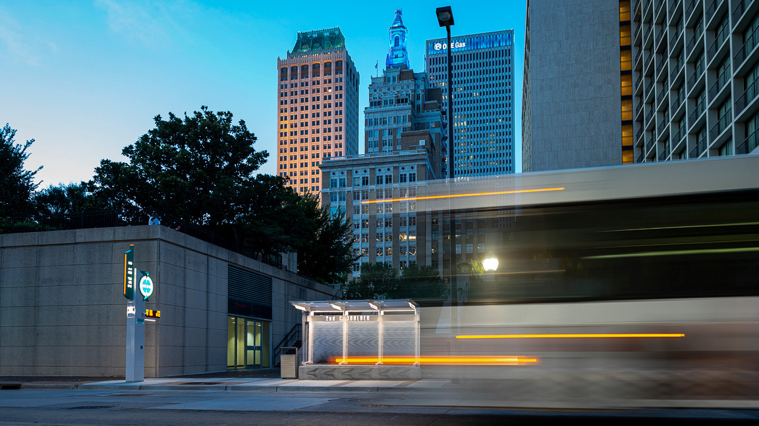
QUESTIONS?

